Slide 1
LIST OF ACTIVITIES
INTRO
SET THE SCENE – PAPER 1 TOPICS – ALL IN BOOKLET FOR REFERENCE
SHARE LEARNING FOCUS
WHAT IS AN ENZYME
ACTIVE SITE AND LOCK AND KEY
LABELS IN BOOKLET
RECAP QUIZ – WHITEBOARDS
DENATURED – CAN DRAW/ANNOTATE AROUND
Q IN BOOKLET
EXAM Q
LINK WITH DIGESTION
LABEL ORGANS
DEFINE DIGESTION
MAIN NUTRIENTS
WHAT BREAKS THEM DOWN?
LABEL WHERE ENZYMES PRODUCED
BROKEN DOWN INTO WHAT?
RECAP QUIZ
BILE
ACID
REHEARSAL
RECAP QUIZ
Notes:
This is something I like to do (CLE) – everyone else can ignore!

Slide 2
Date:
YEAR 10 BIOLOGY SESSION
What are enzymes made of?
Name 3 enzymes?
Which enzyme breaks down protein?

Slide 3
CHECK IT!
What are enzymes made of?
PROTEINS
Name 3 enzymes?
CARBOHYDRASE, PROTEASE AND LIPASE
Which enzyme breaks down protein?
PROTEASE

Slide 4
Learning Focus – Organisation revisit part 1
TOPICS - PAPER 1
CELL BIOLOGY
ORGANISATION
INFECTION
BIOENERGETICS
Notes:
Context – students have been off school for 11 weeks so will need science based reminders of where this all fits in.

Slide 5
Learning Focus – Organisation revisit part 1
This topic includes..
ENZYMES
HEART
BLOOD
HEALTH
PLANT ORGANISATION
Notes:
Setting the scene

Slide 6
Learning Focus – what are enzymes and what is their role in digestion?
Key terms: enzyme, lipase, protease, carbohydrase, active site, substrate, lock and key
Learning Outcomes
I can state what enzymes are made of
I can name different enzymes
I can define digestion
I can name the main nutrients
I can state what the nutrients are broken down into and by what enzymes
I can explain the function of bile and hydrochloric acid in digestion
Notes:
Outcomes for part 1

Slide 7
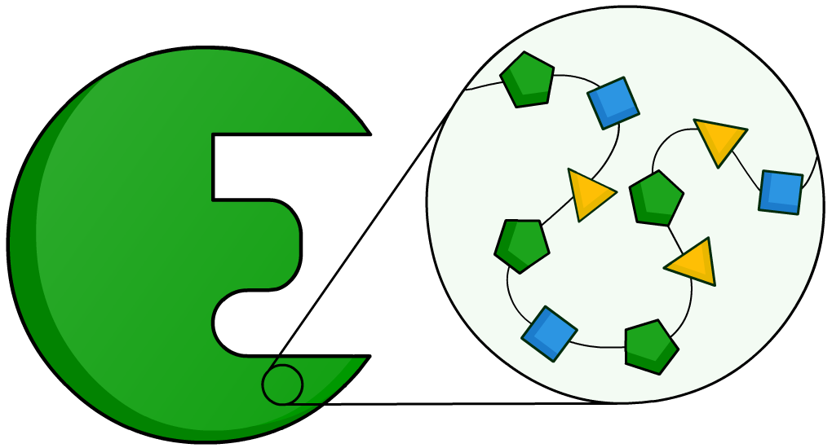
What is an enzyme?
Enzymes are protein molecules
They are made up of long chains of amino acids
These long chains are folded to produce a unique 3D shape which enables other molecules to fit into the protein.

Slide 8
This is how an enzyme and a substrate bind.
Label the enzyme and substrate on the diagram – the diagram is in your booklet on page 3.
Where is the active site? Label this in your booklet
+

Slide 9
This is what happens at the active site
+
↔
↔
+
What is the name of this model?
LOCK AND KEY
Why is it called this?
Notes:
Model around this – label, explain lock and key hypothesis – label the parts of the enzyme

Slide 10
Figure 3 shows a model of an enzyme molecule.
Figure 3
What might an exam question look like?

Slide 11
RECAP QUIZ
What are enzymes made of?
What are the long chains that make up proteins?
What is where the substrate attaches to the enzyme?
Do enzymes speed up or slow down chemical reactions?
Whiteboards ready

Slide 12
What has happened?
What could cause this?
High temperatures or high pH
Shape of active site changed
Substrate no longer fits into active site
Enzyme can no longer speed up the rate of reaction
normal
Notes:
Questioning on denatured – recall – ideas on whiteboards

Slide 13
The enzyme has DENATURED
The shape of active site has changed
So the substrate no longer fits into the enzyme
So the enzyme can no longer speed up the rate of reaction
Notes:
Key points – let’s rehearse these points. Lots of repetition and use of ‘so what’ technique.

Slide 14
TASK
In your own words in the space in your booklet write a description of what ‘denatured’ means
normal
denatured
Help
What has happened to the active site?
What can now no longer fit?
So what does this mean for the enzyme?
Notes:
Rehearsal – can students now apply what they have learnt.

Slide 15
Let’s now link enzymes with digestion
Step 1 – do we know the organs?
Page 4 of your booklet
Notes:
Key VIPS for students to know to fully understand – could talk through functions of each part…questions/quizzing on whiteboards

Slide 16
Step 2 –
What actually is DIGESTION?
The breakdown of large insoluble molecules into smaller soluble molecules
Write the definition in your booklets.
Notes:
Talk through – could draw as a model using the visualiser.

Slide 17
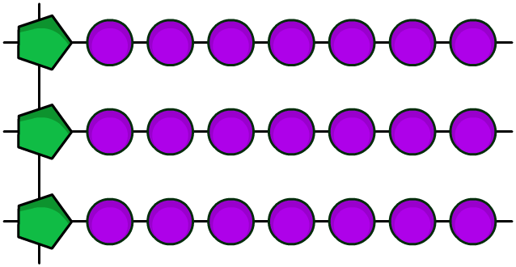
What are the main nutrients?
carbohydrate
molecule
fat
molecule
protein
molecule
But we have to break these down!

Slide 18
So what are the main ENZYMES?
carbohydrate
molecule broken down by CARBOHYDRASE
fat
molecule broken
down by LIPASE
protein
molecule broken down by
PROTEASE

Slide 19
ENZYMES – LET’S PRACTICE THIS!
Carbohydrase breaks down carbohydrates.
Protease breaks down proteins.
Lipase breaks down fats.
Notes:
REPETITION OF KEY POINTS

Slide 20
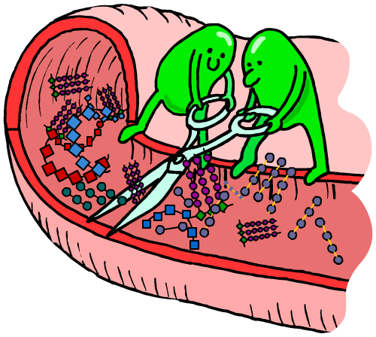
In your booklet…

Slide 21
Label on the diagram below where each enzyme is produced
Use the code P for protease, L for lipase and C for carbohydrase
https://www.youtube.com/watch?v=eSbmJPSnwBs
Notes:
You may skip this part for foundation – time dependent. You may or may not decide to use the video clip.
You may decide not to use the codes – students could write the full name.

Slide 22
Label on the diagram below where each enzyme is produced
C
C
C
Notes:
Talk through together

Slide 23
Label on the diagram below where each enzyme is produced
P
P
P
Notes:
Talk through together

Slide 24
Label on the diagram below where each enzyme is produced
L
L
Notes:
Talk through together

Slide 26
GLUCOSE
AMINO ACIDS
FATTY ACIDS AND GLYCEROL

Slide 27
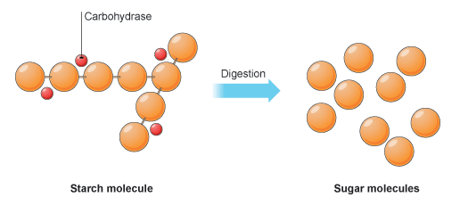
EXTRA TASK
Label the diagrams showing what the enzyme has broken the nutrient down into
EXAMPLE…
Notes:
REPETITION OF KEY POINTS

Slide 28
RECAP QUIZ
What are enzymes made of?
Which enzyme breaks down proteins?
Which enzyme breaks down carbohydrates?
Which enzyme breaks down fats?
What are carbohydrates broken down into?
What are proteins broken down into?
What are fats broken down into?
Name one organ where lipase is produced?
Whiteboards ready

Slide 29
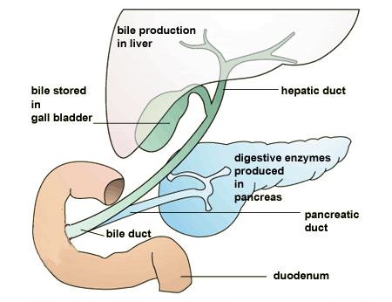
BILE
Bile is made in the liver
Bile is stored in the gall bladder
Bile neutralises the acid from the stomach
Bile emulsifies fats.
What does emulsify mean?
Notes:
You may not have time to do this with lowest F group.

Slide 30
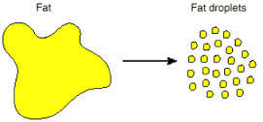
BILE
When bile emulsifies fats, it breaks the fat droplets down into smaller pieces
This creates a larger ____?
So the enzyme acts faster on the fat droplets – which enzyme are we talking about that will break down the fats?

Slide 31
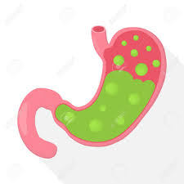
STOMACH
Which acid is in the stomach?
Hydrochloric acid
What does the acid do?
Kills bacteria
Creates optimum conditions for protease enzymes to work
What pH would you expect?
pH 1-3
https://www.youtube.com/watch?v=eSbmJPSnwBs
https://www.youtube.com/watch?v=rlH1ym916Fo
Notes:
Video clips are optional – time dependent

Slide 32
Let’s practice…
Bile is produced in the liver, stored in the gall bladder, then released into the small intestine.
(a) Explain how bile affects the digestion of food in the small intestine.
Neutralises the stomach acid
Emulsifies fats to create a larger surface area for the enzymes to act
Notes:
Rehearsal

Slide 33
Let’s practice…
Name the acid in the stomach and describe its function
Hydrochloric acid
Kills bacteria and creates optimum conditions for the protease enzymes to work
Notes:
Rehearsal

Slide 34
RECAP QUIZ
Where is bile made?
Where is bile stored?
Give one function of bile
Name the acid in the stomach
Give one function of the stomach acid
What are enzymes made of?
Which enzyme breaks down proteins?
Which enzyme breaks down carbohydrates?
Which enzyme breaks down fats?
Whiteboards ready

Slide 35
End of part 1
Notes:
Setting the scene

Slide 36
Part 2- Required Practicals
Effect of pH on enzyme action
This practical looks at how different pH can affect the action of the enzyme AMYLASE
AMYLASE is a carbohydrase enzyme.
What nutrient does it break down?
CARBOHYDRATES – specifically starch
Notes:
Required practicals – choose which one you want to start on dependent on group – food tests or effect of enzymes
Clips available – have tried to simplify method

Slide 37
Task 1 - Method
So how do we do the practical? Can we remember?! We HAVE done it before!
Watch the clip and make notes on your whiteboards of any points you think are important
We will work on writing a method after this…
https://www.youtube.com/watch?v=8Yqbu56ImXk

Slide 38
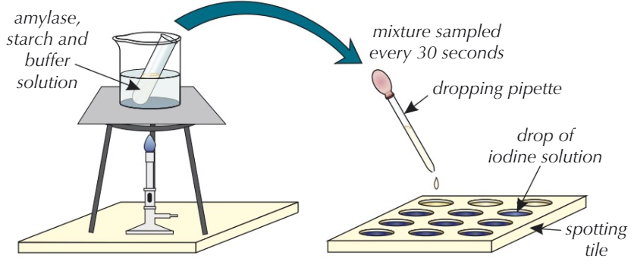
Investigating the effect of pH on amylase activity.
You time how long it takes the starch to be broken down by the AMYLASE enzyme.
You change the pH (using a buffer solution)

Slide 39
Investigating the effect of pH on amylase activity.
How will you know if the starch has been broken down into glucose?
What colour will iodine turn with starch?
BLUE/BLACK
What colour will iodine turn with glucose?
STAYS ORANGE

Slide 40
Investigating the effect of pH on amylase activity.
Variables
Independent=
Dependent=
Control (x2)=

Slide 41
Investigating the effect of pH on amylase activity.
Variables
Independent =
pH of buffer solution
Dependent =
time taken for starch to be broken down
Control (x2) =
volume of amylase, temperature, volume of buffer solution, volume of starch solution

Slide 42
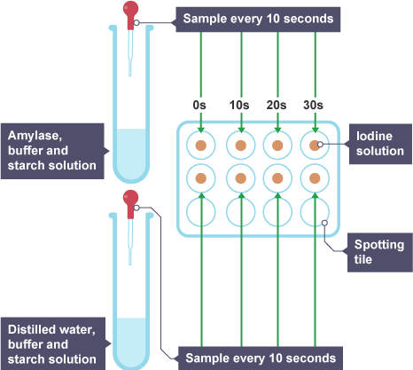
OUTLINE METHOD
Collect your equipment
Set up spotting tile with iodine solution in each well
In a boiling tube: 1 cm³ amylase solution, 2 cm³ of buffer solution – keep this in a water bath at 35ºC
Add 4 cm³of starch solution (which has also been kept in at 35ºC) and start timer
Keep solution in water bath.
Every 30 seconds remove some of the solution and drop into iodine in spotting tile.
Record how long it takes for colour to change (to orange).
Repeat with different pH (using different buffer solutions)

Slide 43
Task 1- Method
Complete the method section in your booklet, you can use words from the equipment list to help.

Slide 44
1. Place 1 drop of iodine into a well on the spotting tile
2. Place labelled test tubes containing the buffered pH solutions, amylase solution and starch solutions into the water bath. Allow them to reach 35°C.
The temperature must be controlled with a water bath
3. Add 2cm3 of one of the buffered solutions to a test tube
4. Add 2cm3 of amylase
5. Start the stop clock
6. Mix using a glass rod
7. After 30 seconds, remove a drop of the mixture and add to the first well of the spotting tile.
8. Repeat, adding a drop of the mixture every 30 seconds
9. Continue until the iodine solution and the amylase/buffer/starch mixture stays orange
When the iodine no longer changes colour, it means that there is no starch present
10. Repeat with solutions of different pH (5,6,7,8)
The optimum pH for amylase is pH6
11. Record the results- time taken for colour to change/ starch to be broken down.

Slide 45
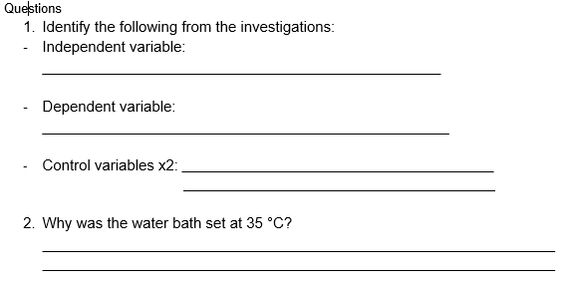
pH
time taken for colour to change/ starch to be broken down.
Volume of starch solution, volume of amylase, temperature of water bath.
Close to body/optimum temperature

Slide 46
Exam Questions

Slide 47
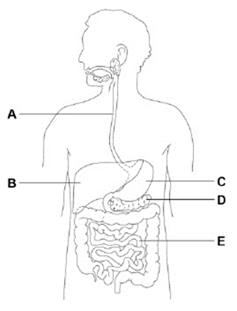
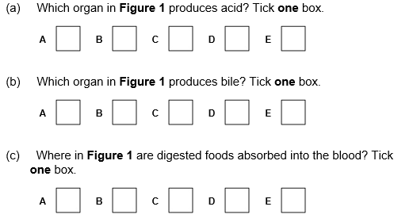

Slide 48
they are too big

Slide 49
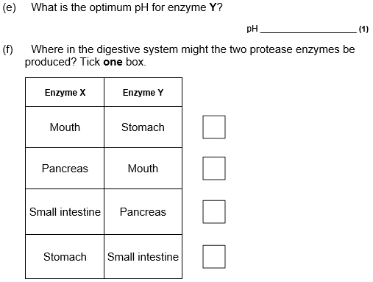
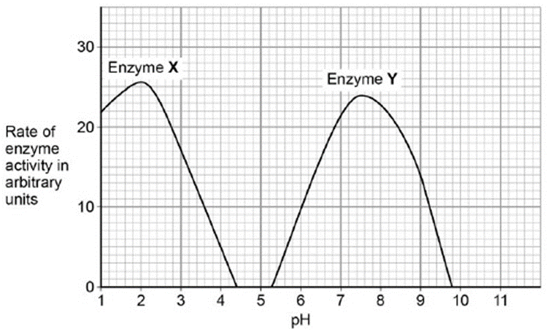
7.5

Slide 50
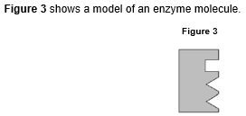
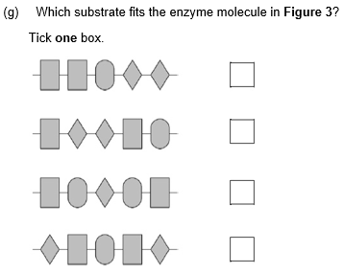

Slide 51
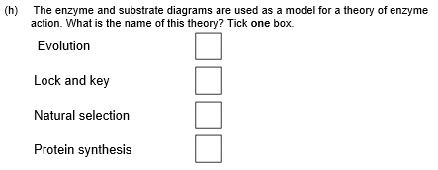

Slide 52
2. Food tests
This practical looks at how we can test for fats, carbohydrates and protein in different types of food.

Slide 53
Task 1 - Method
So how do we do the practical?
Watch the clip and see if you can note down on your whiteboard the tests for
FATS
CARBOHYDRATES – STARCH AND GLUCOSE
PROTEIN
You will be need to write a method following this.
https://www.youtube.com/watch?v=13H1urX3gxI

Slide 54
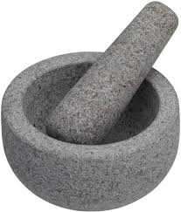
PREPARING ALL FOOD SAMPLES
1. Use a pestle and mortar to grind up a small sample of food.
2. Transfer the food to a beaker. Add distilled water.
3. Stir the mixture so that some of the food dissolves
4. Filter using a funnel with filter paper to obtain as clear as a solution as possible.
RECORD IN YOUR BOOKLET

Slide 55
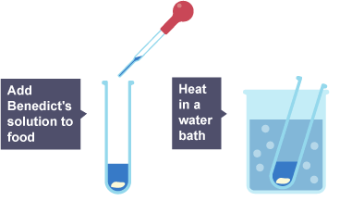
The Benedict’s test for sugars
Place two spatulas of the food sample into a test tube or 1 cm³ if the sample is liquid. Add about 1 cm³ depth of water to the tube and stir to mix.
Add an equal volume of Benedict's solution and mix.
Place the tube in a water bath at about 95°C for a few minutes.

Slide 56
Write how to test for sugars in your booklet

Slide 57
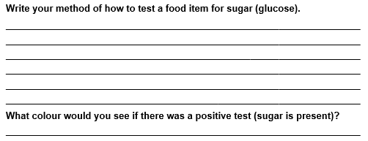
Add 10 drops of Benedict’s solution to your food sample in the test tube
Place the test tube in a beaker of hot water
solution will turn green, yellow, or brick red

Slide 58
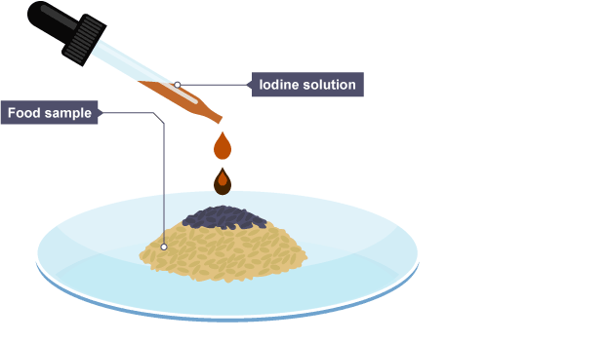
The iodine test for starch
Write how to test for starch in your booklet
Prepare food sample and using a pipette, place a few drops of iodine solution onto the food.
Record colour change.
What would be the result of a positive test for starch?
BLUE BLACK

Slide 59
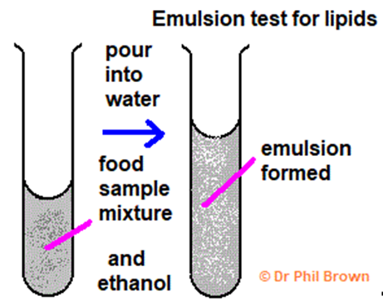
Test for lipids
The test substance is mixed with 2 cm³ of ethanol.
An equal volume of distilled water is added.
A milky-white emulsion forms if the test substance contains lipids.
Write how to test for lipids in your booklet

Slide 60
Test for lipids
Write how to test for lipids in your booklet

Slide 61
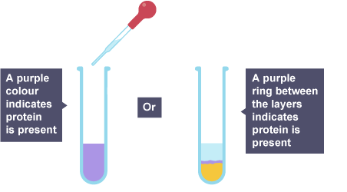
Test for protein
Add 1 cm³ of biuret solution A to the food solution.
Mix the liquids.
Add 1 cm³ of biuret solution B and shake OR add 1 cm³ of biuret solution B carefully down the side of the test tube so as to form two layers.
Write how to test for lipids in your booklet

Slide 62
Test for protein
Write how to test for protein in your booklet and what the colour change will be

Slide 63
Exam Questions

Slide 64
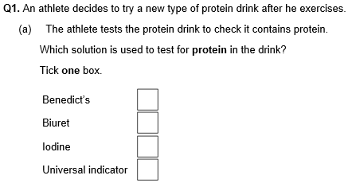

Slide 65
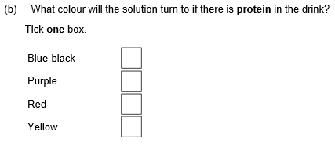

Slide 66
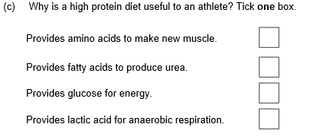

Slide 67
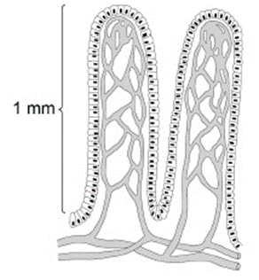
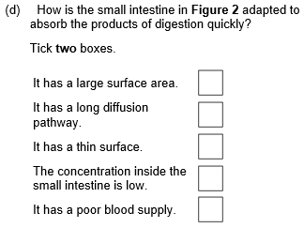

Slide 68
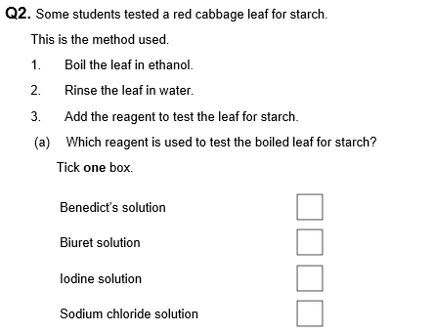

Slide 69
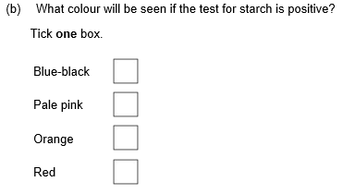

Slide 70
End of part 2

