Slide 1
LIST OF ACTIVITIES

Slide 9
This is what happens at the active site

Slide 11
Why do enzymes speed up reactions?

Slide 12
RECAP QUIZ

Slide 15
TASK

Slide 27
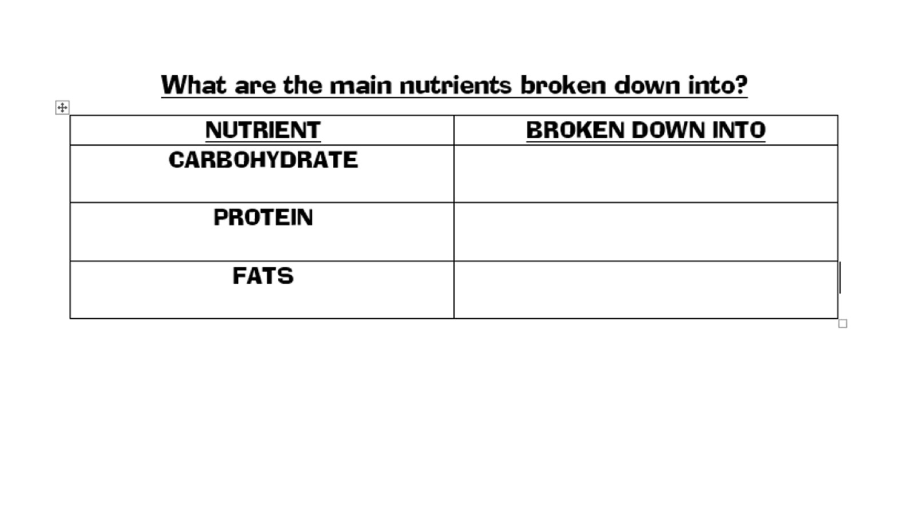

Slide 30
RECAP QUIZ

Slide 31
BILE

Slide 32
BILE

Slide 33
STOMACH

Slide 34
Let’s practice…

Slide 35
Let’s practice…

Slide 36
RECAP QUIZ

Slide 40
Investigating the effect of pH on amylase activity.

Slide 41
Investigating the effect of pH on amylase activity.

Slide 42
Investigating the effect of pH on amylase activity.

Slide 43
Investigating the effect of pH on amylase activity.

Slide 44
OUTLINE METHOD

Slide 49
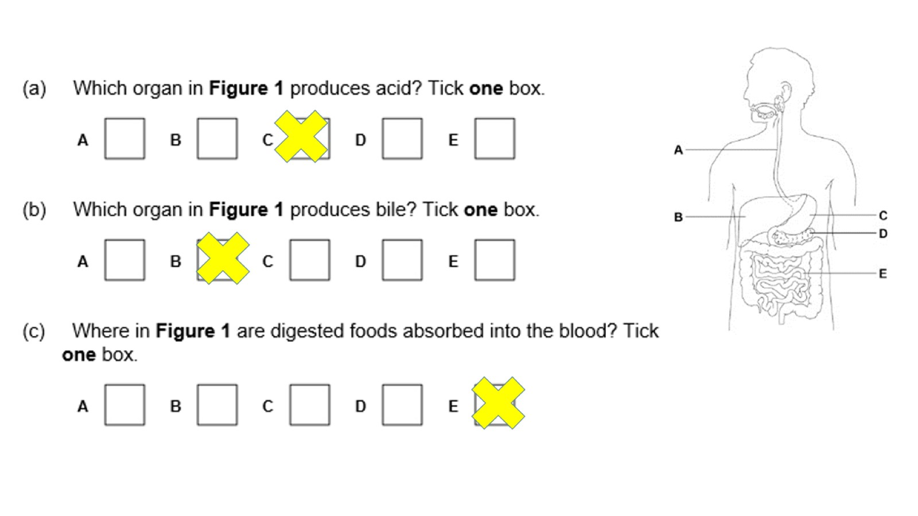

Slide 50
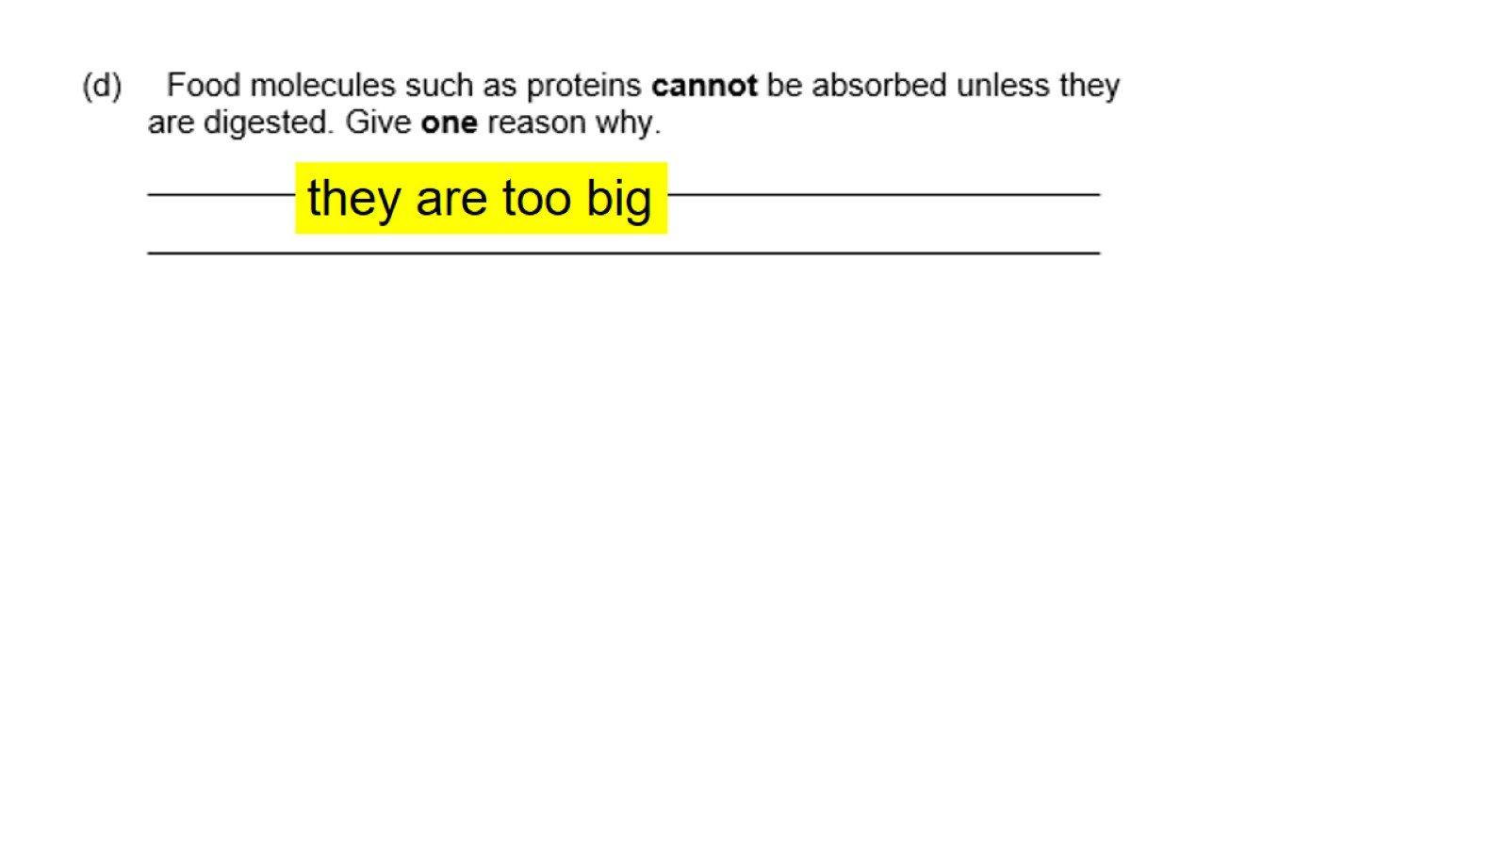

Slide 51
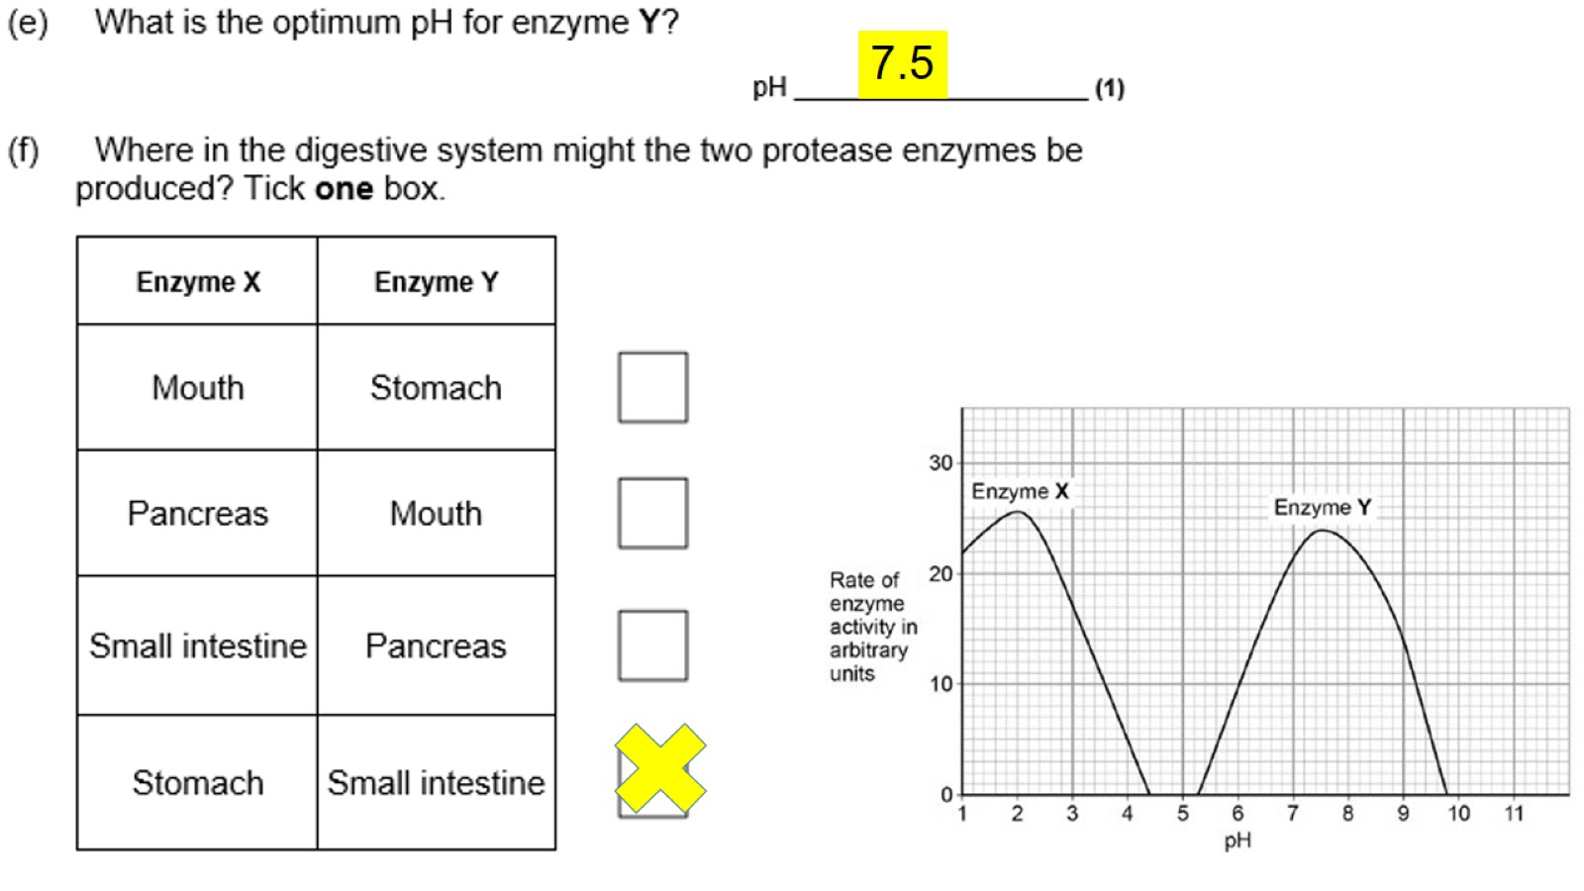

Slide 52
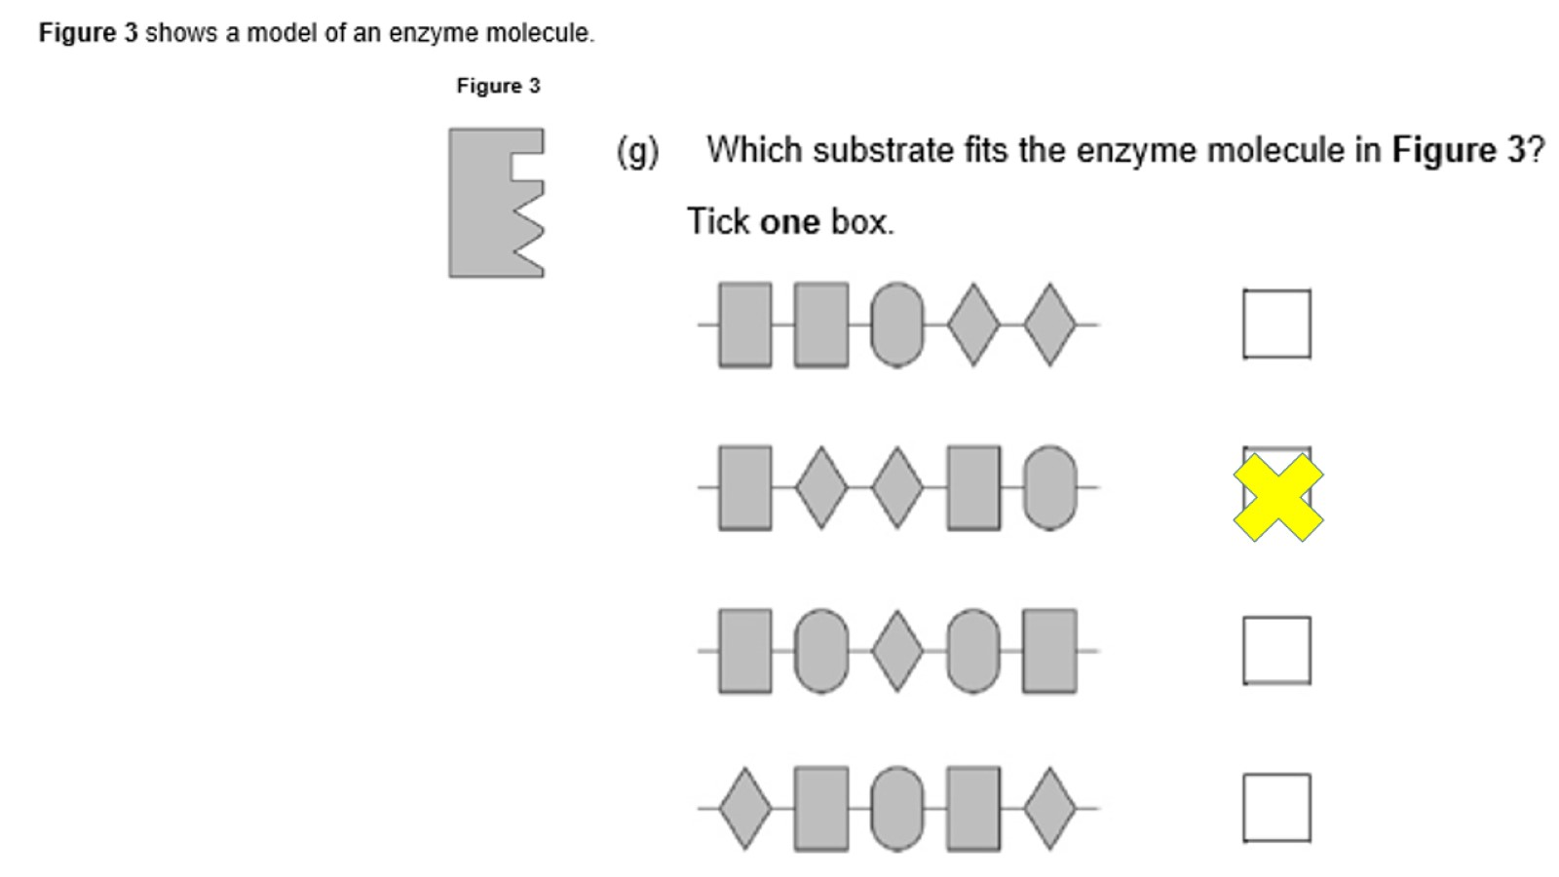

Slide 70
