Slide 1


Date:
YEAR 10 CHEMISTRY SESSION
Name the 3 subatomic particles?
Which particles make up the mass?
How many electrons can go on each shell?
Notes:
Intro.
PCD questions if needed?
Within the booklet for higher there are additional hard learning questions and additional exam questions with mark schemes provided if needed.

Slide 2

CHECK IT!
Name the 3 subatomic particles?
Protons, electrons and neutrons
Which particles make up the mass?
Protons and neutrons
How many electrons can go on each shell?
2 on the 1st shell, 8 on the rest

Slide 3
Learning Focus – Bonding and Structure revisit
TOPICS - PAPER 1
ATOMIC STRUCTURE
BONDING AND STRUCTURE
QUANTITATIVE CHEMISTRY
CHEMICAL CHANGES
ENERGY CHANGES
Notes:
Context – students have been off school for 11 weeks so will need science based reminders of where this all fits in in terms of Chemistry.

Slide 4
Learning Focus – Bonding and Structure revisit
This topic includes..
IONIC BONDING
COVALENT BONDING
METALLIC BONDING
HOW BONDING AND STRUCTURE REALTES TO THE PROPERTIES OF A SUBSTANCE
GIANT COVALENT STRUCTURES
Notes:
Setting the scene

Slide 5



Learning Focus –how does ionic bonding relate to a substance's properties?
Key terms: ion, electrostatic, oppositely charged, attraction, giant lattice, electrons
Learning Outcomes
I can give the definition of an atom, element and compound.
I can describe the structure of an atom
I can explain how atoms become ions.
I can describe an ionic bond.
I can explain how ionic bonds are formed in terms of electrons.
I can explain how ionic bonds relate to the properties of an ionic compound.
Notes:
Learning outcomes for part 1

Slide 6
Atoms, elements, compounds and mixtures
On your whiteboard write 1-4.
Identify which is the atom, element, compound and mixture.
Give a reason for each of your choices.
1
2
3
4

Slide 7
Atoms, elements and compounds.
Check your understanding. Answer all questions on page 2 of your booklet.

Slide 8
Atoms, elements and compounds
What do you already know? Check your answers
An atom is the smallest unit of an element.
An element is made up of one type of atom only.
A compound contains two or more types of atom which are chemically joined.
Elements form compounds to obtain a full outer shell of electrons.

Slide 9
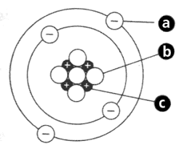
A = Electron
An electron has a negligible mass
It has a charge of -1
B = Neutron
A neutron has a mass of 1
It has no charge
C = Proton
A proton has a mass of 1
A proton has a charge of +1

Slide 10
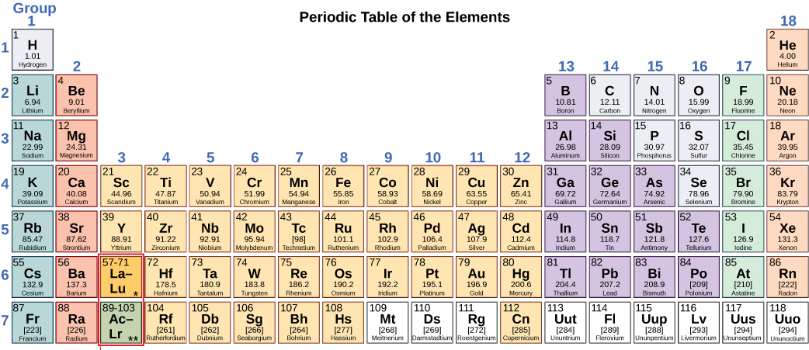
Linking the structure of an atom to the Periodic table.
On your mini whiteboard I want you to write down as much information about Lithium as you can using its position on the Periodic table and numbers provided.
Hint – think about:
The group number.
The period number.
Atomic number
Relative atomic mass
Li
3
7

Slide 11
Lithium – check your ideas.
Group 1 – 1 electron on its outer shell.
It needs to lose 1 electron to get a full outer shell of electrons.
Period 2 – it has two electron shells.
Atomic number of 3 – it has 3 protons and 3 electrons.
Mass of 7 –
  this is the number of protons and neutrons added together.
  It has 4 neutrons as we already know the number of protons.
Li
3
7

Slide 12
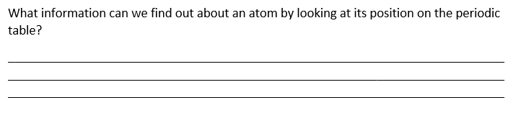

Answer these questions on page 4 of your booklet.
Atoms have equal numbers of positive protons and negative electrons.
The charges cancel each other out.

Slide 13
Electronic structures.
On your mini whiteboard draw the electronic structure of sodium.
What rules do we follow when arranging the electrons in shells?
What does the electronic structure tells us about the group that sodium is in?
11
Na
23

Slide 14


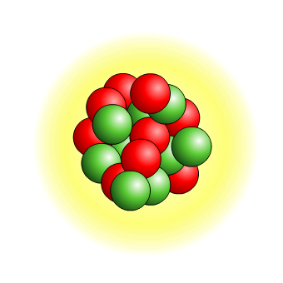

How many electrons per shell?
Each shell has a maximum number of electrons that it can hold. Electrons will fill the shells nearest the nucleus first.
1st shell holds
a maximum of
2 electrons
2nd shell holds
a maximum of
8 electrons
3rd shell holds
a maximum of
8 electrons
This electron arrangement is written as 2,8,8.

Slide 15
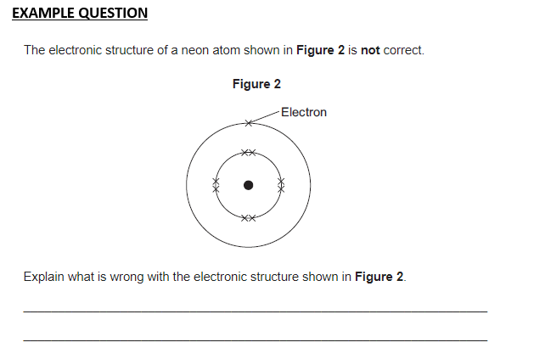
Example question
Answer the exam question on page 3 of your booklet.
too many electrons in the first energy level or inner shell.
too few electrons in the second energy level or outer shell.
neon does not have 9 electrons or neon has 10 electrons.

Slide 16
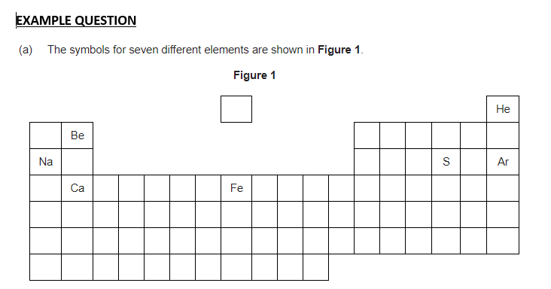

Answer the example questions on pages 4 and 5.
Na

Slide 17

Answer the example questions on pages 4 and 5.
Be and Ca
Or
He and Ar
Na

Slide 18
Answer the example questions on pages 4 and 5.
Ca and Fe
Or
Na, S and Ar

Slide 19

Answer the example questions on pages 4 and 5.
He or Ar

Slide 20
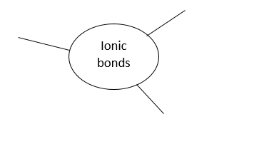
Ionic Bonds
Complete the spider diagram on page 6.

Slide 21
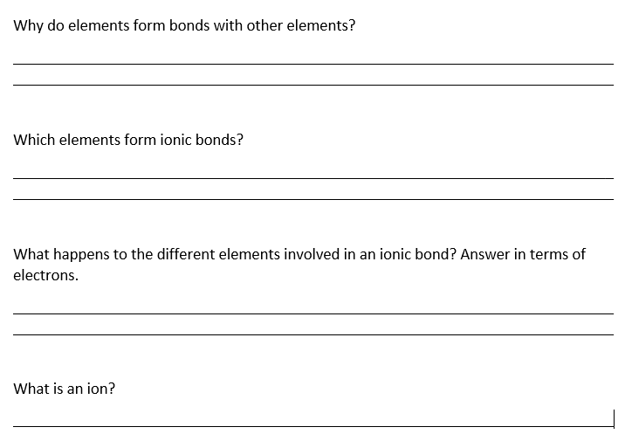
Ionic bonds
Using the information from your spider diagram answer the questions on page 7 of your booklet.

Slide 22
To get a full outer shell of electrons.
Metals and non-metals.
Metals lose electrons to become a positively charged ion.
Non – metals gain electrons to become negatively charged ions.
A charged particle with a full outer shell of electrons.

Slide 23
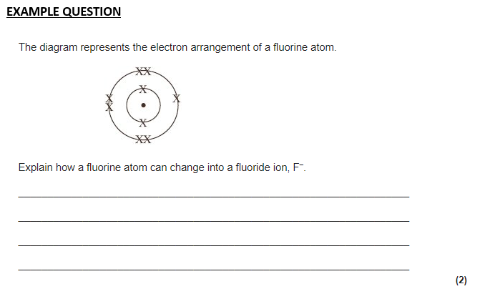
one electron
is gained

Slide 24
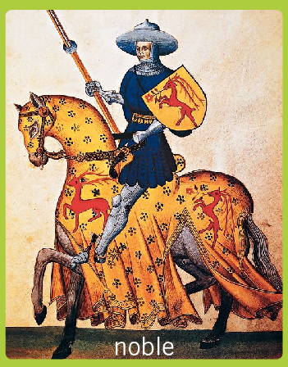
Why do elements react?
Atoms react because they want to be like the noble gases.
Atoms are trying to achieve a full outer shell of electrons.

Slide 25
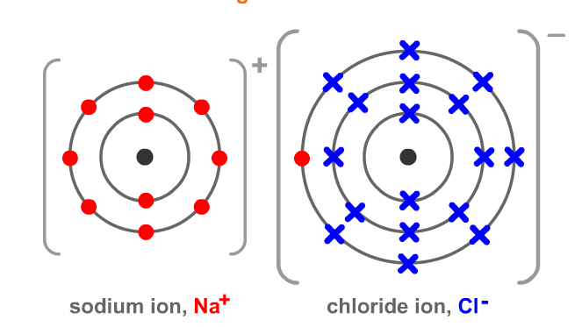
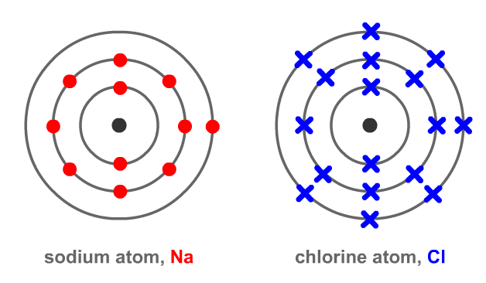
How do atoms gain a full outer shell?
In ionic bonding atoms lose or gain electrons from another atom so that both atoms have a full outer shell.
Ionic bonds form between a metal and a non-metal.
It involves the transfer of electrons.
A metal atom loses electrons.
non-metals gain electrons.

Slide 26
Ions – answer on your mini whiteboard.
Why are atoms neutral but an ion is charged?
Atoms – they have the same number of POSITIVE protons and NEGATIVE electrons which cancel each other out.
Ions – have lost or gained electrons so they no longer have the same numbers of protons and electrons.
Na
11
P =
E =
N =
P =
E =
N =
11
10
12
11
11
12
23

Slide 27
Links to ionic bonding, atomic structure and the Periodic table
On your mini whiteboard – how does our knowledge of atomic structure and the periodic table help us to work what type of ion each atom forms?
Metals
Found on the left hand side of the Periodic Table.
Form positive ions.
Group number tells many electrons they will lose from the outer shell.
This tells us how positive the ion will be.

Slide 28
Links to ionic bonding, atomic structure and the Periodic table
On your mini whiteboard – how does our knowledge of atomic structure and the periodic table help us to work what type of ion each atom forms?
Non-metals
Found on the right hand side of the Periodic Table.
Form negative ions.
Group number tells us how many electrons are on the outer shell.
This tells us how many electrons they need to gain to get a full outer shell (8 electrons).
The number of electrons they gain tells us how negative the ion will be.

Slide 29
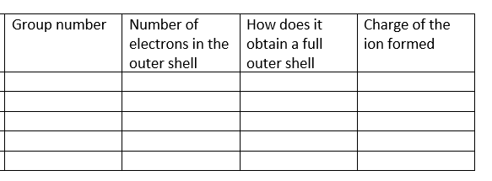
Links to ionic bonding, atomic structure and the Periodic table.
Name of the element
Potassium
Calcium
Sulphur
Iodine
Neon
1
1
Lose 1 electron
+1
2
2
Lose 2 electrons
+2
6
6
Gain 2 electrons
-2
7
7
Gain 1 electron
-1
0
8
Already has one
Does not react

Slide 30
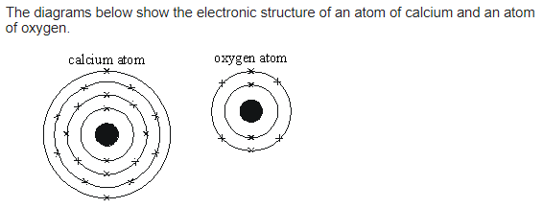
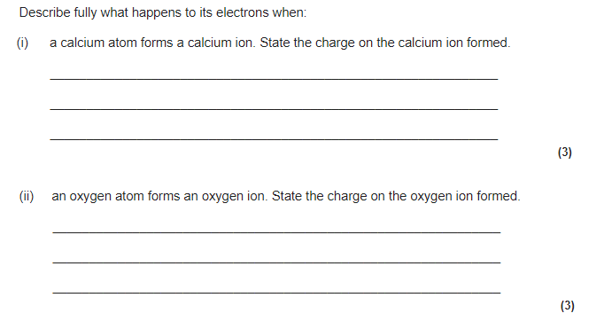
Example question
Have a go at the exam question on page 8 of your booklet.

Slide 31
Check your answers.
A calcium atom loses
2 electrons from its outer shell.
To become +2 ion.
An oxygen atom gains
2 electrons
To become -2 ion.

Slide 32
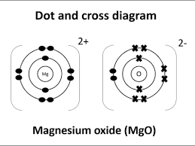
What is an ionic bond?
On your mini whiteboard describe what an ionic bond is.
Use the picture below to help.
Think about what an ionic compound is made up of and why they are attracted towards each other.

Slide 33
What is an ionic bond?
Oppositely charged ions
Held together by strong electrostatic forces.

Slide 34
What structure do ionic compounds have?
Describe the structure of ionic compounds.
Use the picture below to help.
Think about your description of an ionic bond to explain why they have this structure.
+
-
+
-
+
-
+
-
+
+
-
+
-
+
-
-
+
-
+
+
+
-
-
-
+
+
-
+
+
-
+
-
-
+
-
+
+
-
+
-
+
-
-
+
-
-
+
-
+
-
+
+
-
+
+
-
+
-
+
-
-
+
-
+
-
+
+
-
+
-
+
-
-
+
-
+
-
+
+
-
+
-
+
-
-
+
-
+
-
+

Slide 35
What structure do ionic compounds have?
+
-
+
Oppositely charged ions.
-
+
-
+
-
+
Forming a giant ionic lattice.
Exerts an electrostatic force in all directions.
+
-
+
-
+
-
-
+
-
+
+
+
-
-
-
+
+
-
+
+
-
+
-
-
+
-
+
+
-
+
-
+
-
-
+
-
-
+
-
+
-
+
+
-
+
+
-
+
-
+
-
-
+
-
+
-
+
+
-
+
-
+
-
-
+
-
+
-
+
+
-
+
-
+
-
-
+
-
+
-
+
More and oppositely charged ions can be added on.

Slide 36
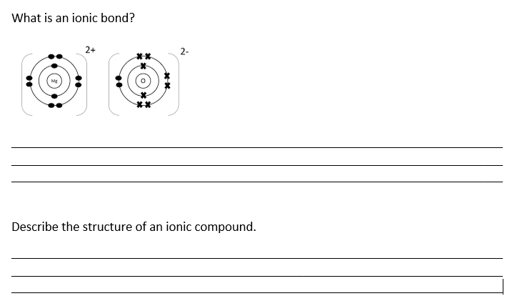
Answer the questions on page 9 of the booklet.
A strong electrostatic force between oppositely charged ions.
A giant ionic lattice
The electrostatic force is exerted in all directions.
More and more ions are added to form the giant structure.

Slide 37
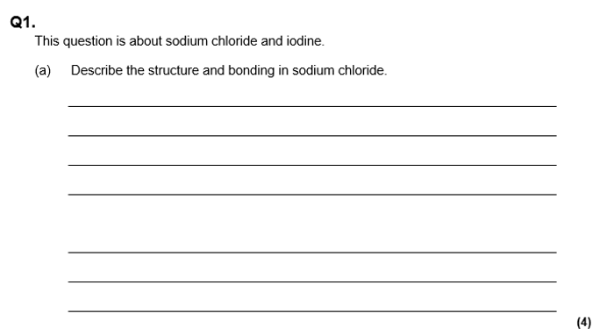
Example question
giant structure
ionic compound which contains ions
It is made up of Na⁺ and Cl⁻ ions
Ions are held together by electrostatic forces of attraction

Slide 38
How do ionic compounds form?
On your mini whiteboard - use the diagram below to explain how sodium chloride is formed from atoms of sodium and chlorine.

Slide 39
Check your answers
The sodium atom loses one electron.
The sodium atom becomes +1 ion.
The chlorine atom gains one electron.
The chlorine atom becomes a -1 ion.

Slide 40
How do ionic compounds form?
On your mini whiteboard - use the diagram below to explain how calcium chloride is formed from atoms of calcium and chlorine.
Challenge – what would the formula of calcium chloride be?
Remember how the Periodic table can help.

Slide 41
Check your answer
The calcium atom loses two electrons.
The calcium atom becomes a 2+ ion.
Two chlorine atoms gain 1 electron each.
The chlorine atoms become -1 ions.
The formula would be CaCl₂

Slide 42
How do ionic compounds form?
On your mini whiteboard - use the diagram below to explain how lithium oxide is formed from atoms of lithium and oxygen.
Challenge – what would the formula of lithium oxide be?
Remember how the Periodic table can help.

Slide 43
Check your answer
The lithium atoms lose one electron.
The lithium atoms become 1+ ions.
The oxygen atom gains 2 electrons
The oxygen atom becomes a 2- ion.
Two lithium atoms are needed for every one oxygen atom.
The formula would be Li₂O

Slide 44
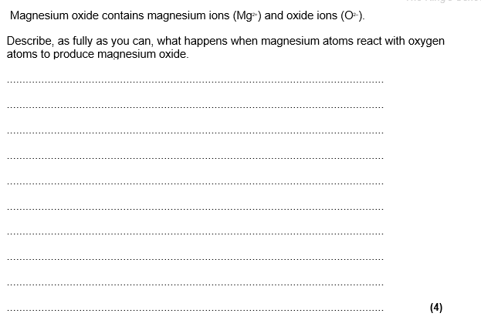
Example question – complete the example questions on pages 10 and 11.
magnesium loses 2 electron(s) to become 2+ion
oxygen gains 2 electron(s) to become 2-ion
(electrostatic) attraction between oppositely charged ions

Slide 45
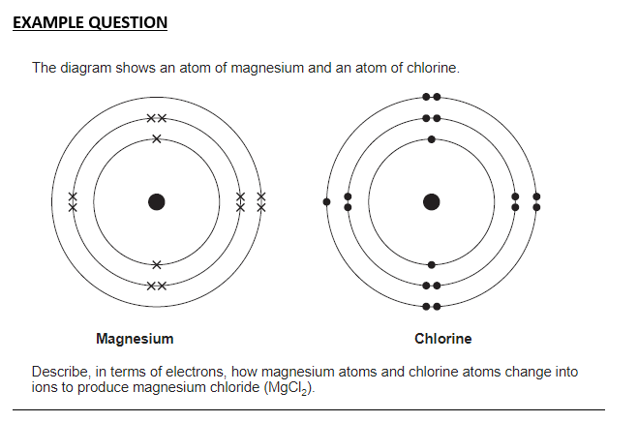
magnesium loses 2 electrons
Magnesium becomes a 2+ ion.
chlorine gains an electron to become a 1- ion.
two atoms of chlorine are needed to gain one electron each

Slide 46
Recap quiz on your mini whiteboard
What is an ion?
A charged particle formed when atoms lose or gain electrons.
Describe what an ionic bond is.
A strong electrostatic force between oppositely charged ions.
Describe the structure of ionic compounds.
A giant ionic lattice.

Slide 47
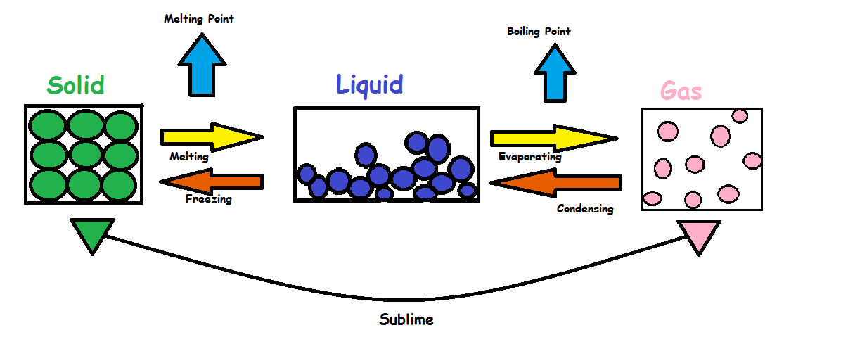
Properties of ionic compounds
Ionic compounds are usually solids at room temperature.

Slide 48
On your mini whiteboard
How would you describe the melting point of ionic compounds?
Describe the forces between the particles in a solid compared to a liquid.
How would you turn a solid into a liquid?
How much energy would you need if the substance contained ionic bonds?

Slide 49
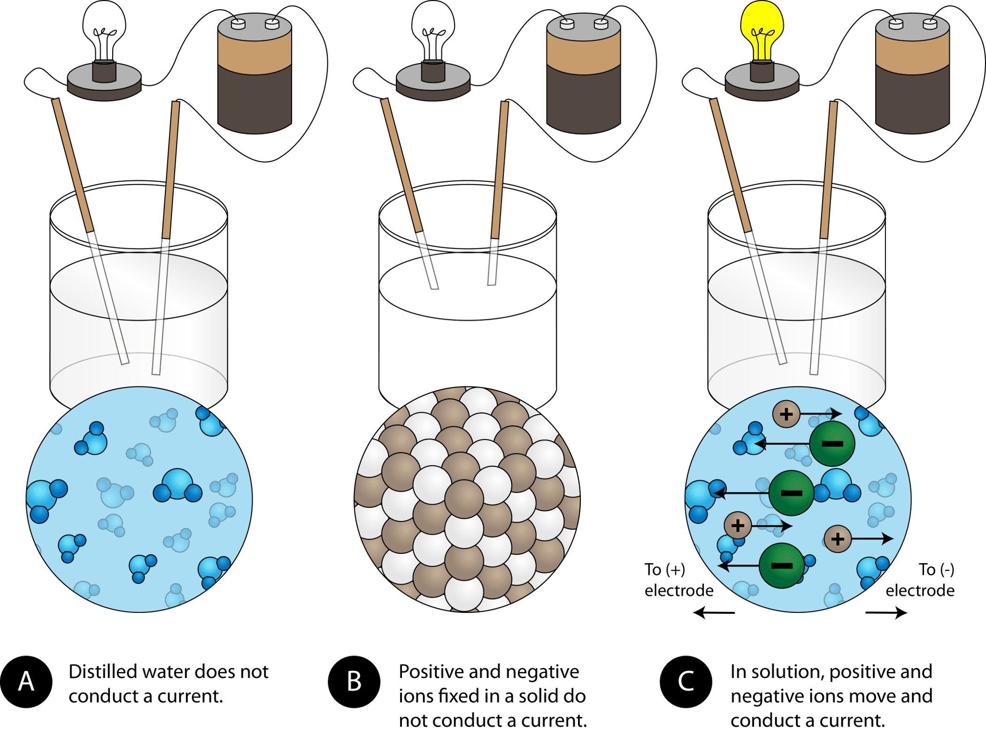
Properties of ionic compounds
On your mini whiteboard
What is needed to conduct electricity?
Why can dissolved or molten ionic compounds conduct electricity but not solids?
What does the charged particle need to be able to do to carry a charge throughout the substance?
We need a charge particle.
Do ionic compounds contain charged particles?

Slide 50
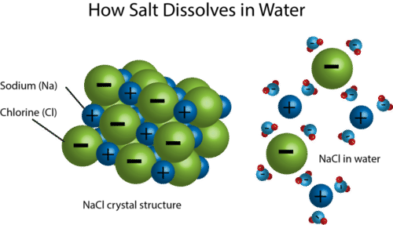
Properties of ionic compounds
On your mini whiteboard
Why do ionic compounds dissolve in water? Use the picture to support your explanation.
The water molecules are breaking apart the lattice.

Slide 51
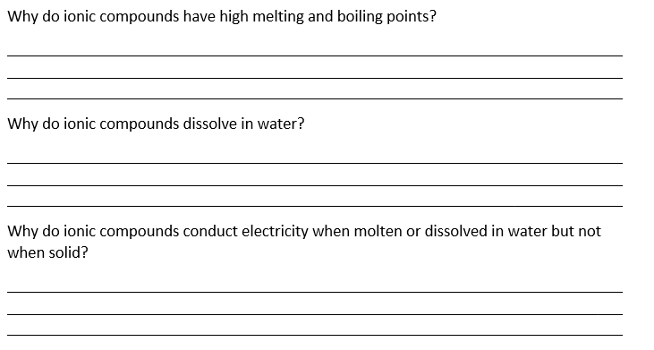
Answer the questions in your booklet.
They have strong electrostatic forces between oppositely charged ions.
A lot of energy is needed to overcome these forces.
The water molecules break apart the lattice.
The ions need to be able to move to carry a charge throughout the substance.
The ions can move when liquid but not when solid.

Slide 52
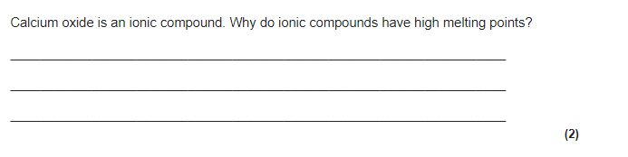
Example question – answer the questions on pages 12 and 13
There are strong electrostatic forces between the oppositely charged ions.
A lot of energy is needed to overcome these forces.

Slide 53
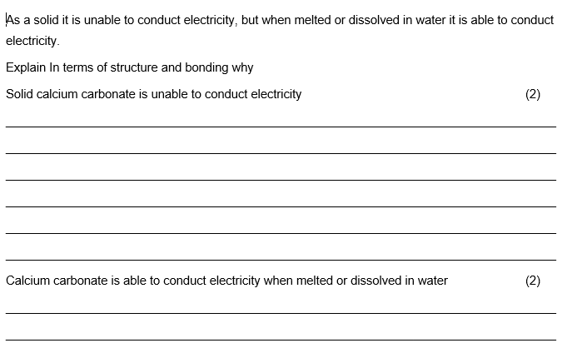
The ions in a solid are unable to move.
This means the ions cannot carry a charge throughout the structure.
The ions can moved when the ionic compound is a liquid.
This means they can carry a charge throughout the structure.

Slide 54
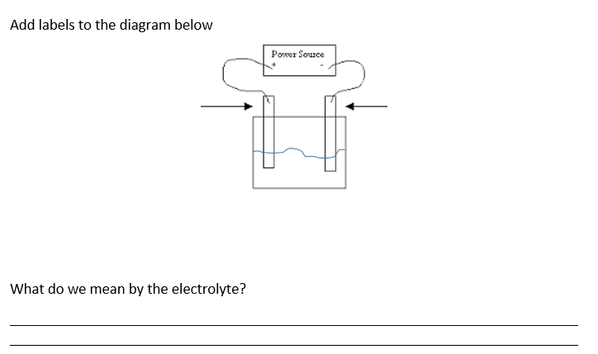
Part 3 - Electrolysis
On your mini whiteboard draw the diagram below and add as many labels as you can.
Add any other notes or key words about electrolysis.

Slide 55
Negative electrode
Cathode
Positive electrode
Anode
Electrolyte
This is the liquid we are electrolysing. This will be a molten or dissolved ionic compound, we use electricity to split an ionic compound into its elements.

Slide 56
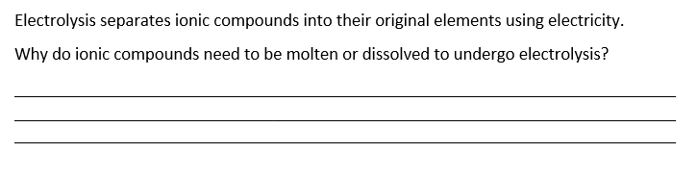
Linking electrolysis to ionic compound properties.
The ions need to be able to move towards an electrode to form a neutral atom.
The ions cannot move in a solid.

Slide 57
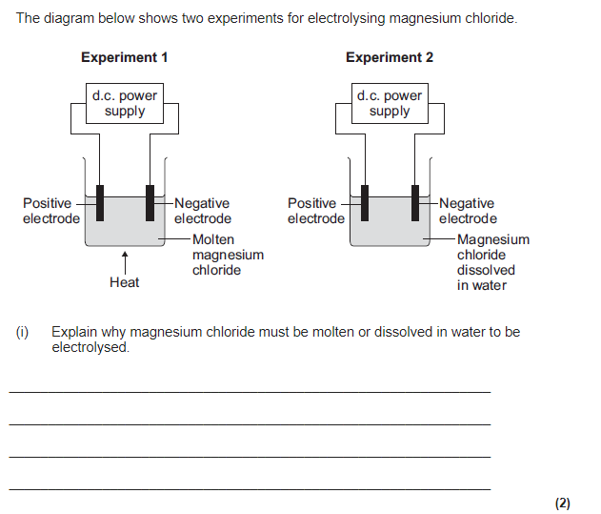
Example question page 15
because ions can move
to the electrodes
or
The ions can carry a charge

Slide 58
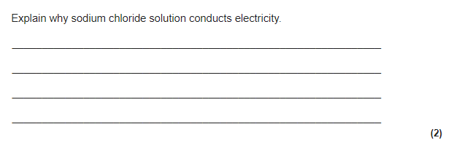
because there are ions in sodium chloride
which can move and carry a charge

Slide 59
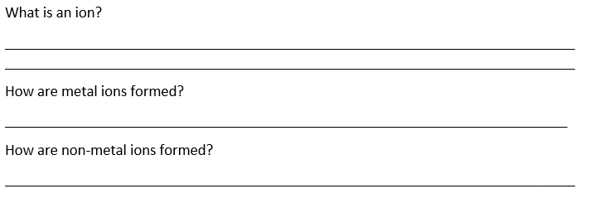
Recap
  A charged particle
Metal atoms lose electrons to form positively charged ions.
Non-metal atoms gain electrons to form negatively charged ions.

Slide 60
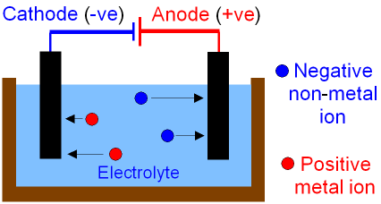
What is electrolysis?
Electrolysis is the reverse process of ionic bonding,
Instead of atoms forming ions, ions form their original atom.
This happens at the electrodes.

Slide 61
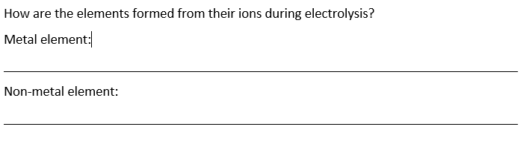
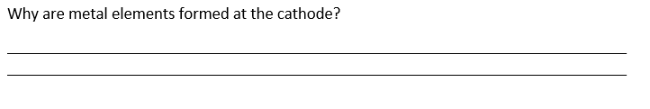
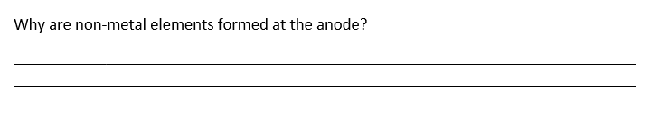
Use your knowledge on ionic bonding to answer the questions.
The positive metal ion gains negative electrons to become a neutral atom.
The negative non-metal ion loses negative electrons to become a neutral atom.
The positive metal ion is attracted towards the negative cathode because opposites attract.
The negative non-metal ion is attracted towards the positive anode because opposites attract.

Slide 62
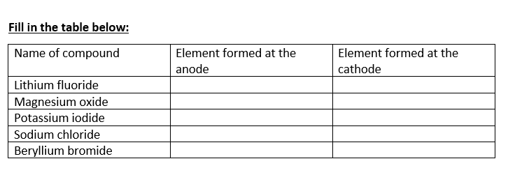
Check your understanding
Fluorine
Lithium
Oxygen
Magnesium
Iodine
Potassium
Chlorine
Sodium
Bromine
Beryllium

Slide 63
How are atoms formed?
On your mini whiteboard:
What happens to the following ions during electrolysis that results in the neutral atom being formed?
Na⁺
Ca²⁺
O²⁻
F⁻

Slide 64
Check your answers
Na⁺
Na⁺ ion gains an electron to become Na
Ca²⁺
Ca²⁺ gains two electrons to become Ca
O²⁻
2 lots of O²⁻ loses two electrons each to become O₂
F⁻
2 lots of F- loses 1 electron each to become F₂

Slide 65
Half Equations
Half equations show the reactions at the electrodes. Here’s how to write a half equation for the reaction that takes place at the negative electrode:
Step 1: Write the symbol for the positive ion in the electrolyte on the left-hand side of the equation.
Step 2: Write the symbol for the neutral atoms or molecules produced on the right-hand side of the equation.
Step 3: Balance the number of atoms in the equation.
Step 4: Balance the charges by adding electrons (shown as e–).
You can do the same to get the half equation for the reaction at the positive electrode, starting with the negative ion on the left-hand side of the equation.

Slide 66
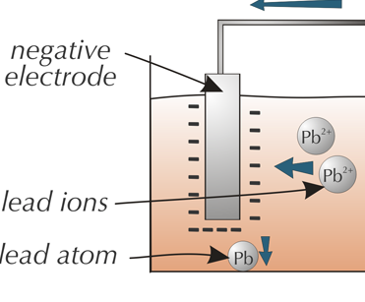
At The Negative Electrode

Slide 67
Step One
Write the symbol for the positive ion in the electrolyte on the left-hand side of the equation.
Pb²⁺

Slide 68

Step Two
Write the symbol for the neutral atoms or molecules produced on the right-hand side of the equation.

Slide 69
Step Three
Balance the number of atoms in the equation.
There’s one lead ion on the left and one lead atom on the right, so the number of atoms is balanced.

Slide 70

Step 4
Balance the charges by adding electrons (shown as e–).

Slide 71
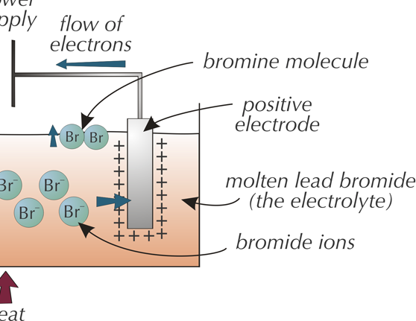
At The Positive Electrode

Slide 72
Step One
Write the symbol for the positive ion in the electrolyte on the left-hand side of the equation.
Br–
Don’t forget that Iodine, nitrogen, hydrogen, chlorine, oxygen, bromine, fluorine always come in pairs!

Slide 73

Step Two
Write the symbol for the neutral atoms or molecules produced on the right-hand side of the equation.

Slide 74

Step Three
Balance the number of atoms in the equation.
There are two bromine atoms on the right so there need to be two bromide ions on the left to balance the equation.

Slide 75


Step 4
Balance the charges by adding electrons (shown as e–).
Or, you could subtract two electrons from the left-hand side to give both sides a charge of zero.
This would give you this half equation:

Slide 76
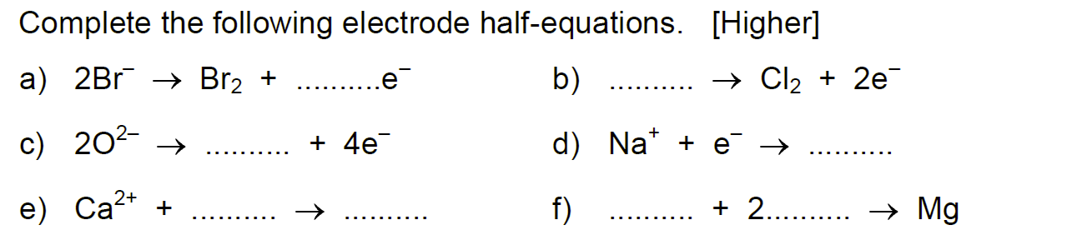

Slide 77
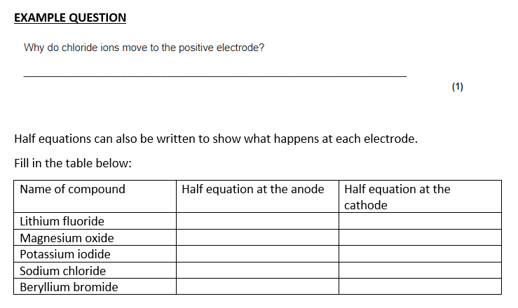
Example questions
Chloride ions are negative and opposites attract.

Slide 78
Example questions

Slide 79
Check your answers
Name of compound | Half equation at the anode | Half equation at the cathode
Lithium fluoride | Li⁺ + e⁻ → Li | 2F⁻ → F₂ + 2e⁻
Magnesium oxide
Potassium iodide
Sodium chloride
Beryllium bromide

Slide 80
Check your answers
Name of compound | Half equation at the anode | Half equation at the cathode
Lithium fluoride | Li⁺ + e⁻ → Li | 2F⁻ → F₂ + 2e⁻
Magnesium oxide | Mg²⁺ + 2e⁻ → Mg | 2O²⁻ → O₂ + 4e⁻
Potassium iodide
Sodium chloride
Beryllium bromide

Slide 81
Check your answers
Name of compound | Half equation at the anode | Half equation at the cathode
Lithium fluoride | Li⁺ + e⁻ → Li | 2F⁻ → F₂ + 2e⁻
Magnesium oxide | Mg²⁺ + 2e⁻ → Mg | 2O²⁻ → O₂ + 4e⁻
Potassium iodide | K⁺ + e⁻ → K | 2I⁻ → I₂ + 2e⁻
Sodium chloride
Beryllium bromide

Slide 82
Check your answers
Name of compound | Half equation at the anode | Half equation at the cathode
Lithium fluoride | Li⁺ + e⁻ → Li | 2F⁻ → F₂ + 2e⁻
Magnesium oxide | Mg²⁺ + 2e⁻ → Mg | 2O²⁻ → O₂ + 4e⁻
Potassium iodide | K⁺ + e⁻ → K | 2I⁻ → I₂ + 2e⁻
Sodium chloride | Na⁺ + e⁻ → Na | 2Cl⁻ → Cl₂ + 2e⁻
Beryllium bromide

Slide 83
Check your answers
Name of compound | Half equation at the anode | Half equation at the cathode
Lithium fluoride | Li⁺ + e⁻ → Li | 2F⁻ → F₂ + 2e⁻
Magnesium oxide | Mg²⁺ + 2e⁻ → Mg | 2O²⁻ → O₂ + 4e⁻
Potassium iodide | K⁺ + e⁻ → K | 2I⁻ → I₂ + 2e⁻
Sodium chloride | Na⁺ + e⁻ → Na | 2Cl⁻ → Cl₂ + 2e⁻
Beryllium bromide | Be²⁺ + 2e⁻ → Be | 2Br⁻ → Br₂ + 2e⁻

Slide 84
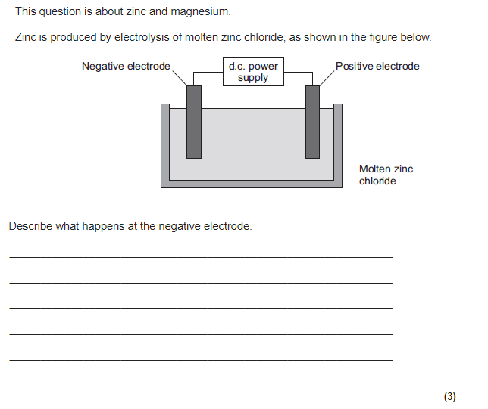
zinc ions gain electrons
2 (electrons)
zinc is formed

Slide 85
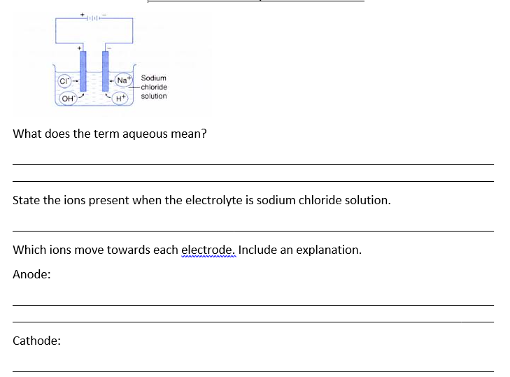
Electrolysis of aqueous solutions
Dissolved in water. The word solution is also used to show the compound is dissolved in water.
OH⁻ H⁺ Na⁺ Cl⁻
OH⁻ and Cl⁻ because the anode is positive and opposites attract.
H⁺ and Na⁺ because the cathode is negative and opposites attract.

Slide 87
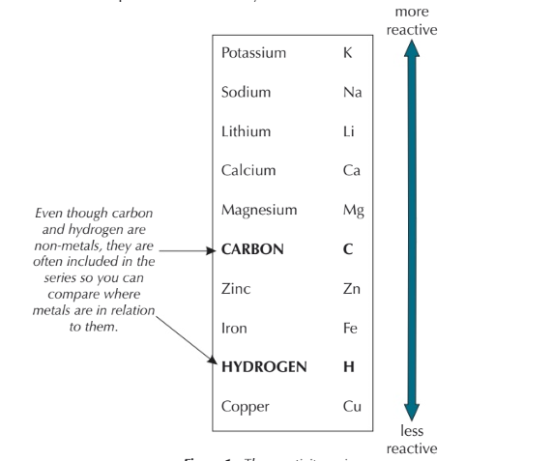
Reactivity series
You need to know this!

Slide 88
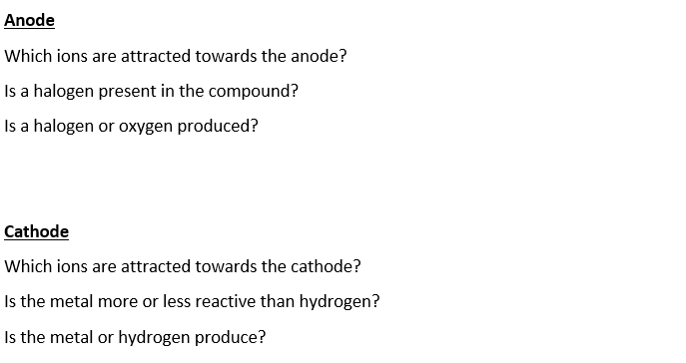
Predicting the products of aqueous electrolysis.
Sodium chloride solution.
OH⁻ and Cl⁻
Yes
Halogen
Chlorine is produced at the anode
H⁺ and Na⁺
More reactive
Hydrogen is produced at the cathode

Slide 89
Predicting the products of aqueous electrolysis.
Sodium chloride solution.
On your min whiteboard predict the products at the anode and cathode for the following:
Molten lead bromide
Copper chloride solution
Molten potassium chloride
Sodium sulphate solution

Slide 90
Check your answers.
Molten lead bromide
Cathode: lead Anode: bromine
Copper chloride solution
Cathode: copper Anode: chlorine
Molten potassium iodide
Cathode: potassium Anode: iodine
Sodium sulphate solution
Cathode: hydrogen Anode: oxygen

Slide 91
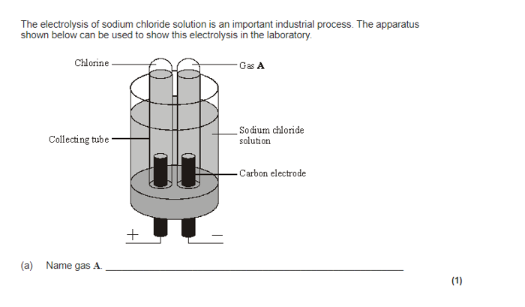
hydrogen

Slide 92
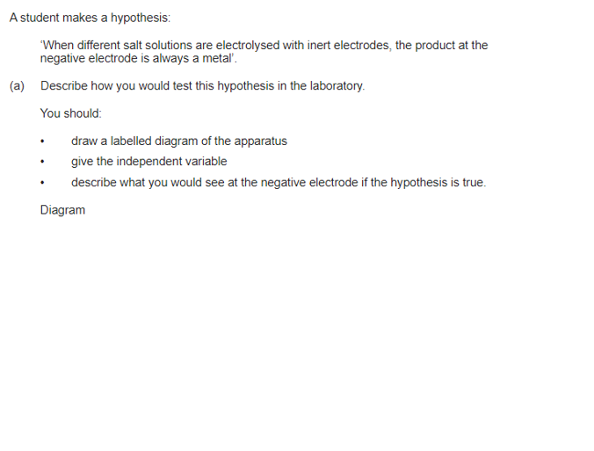
complete circuit with power supply
1
test solution in beaker or other appropriate apparatus
1
Electrodes 1

Slide 93
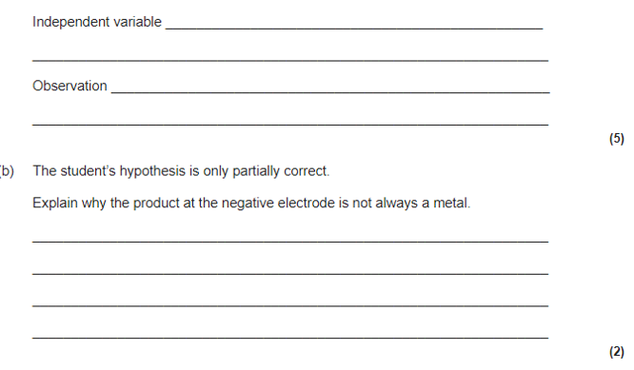
(independent variable)
salt solutions (with different metal ions)
1
(observation)
solid / metal deposit on the negative electrode
1
sometimes hydrogen is produced
1
because the metal is more reactive than hydrogen

Slide 94
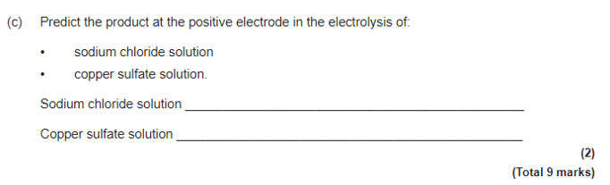
chlorine
oxygen

