Slide 1

Planner
Please have your planner open on today’s date
Date:
Title: Maths in Science
Copy
Which of these is smaller: a cell or an organ?
True or False: a Human is an animal.
Name an organ you would find in the Digestive System.
What systems does the Heart belong to?
What is inside the cell nucleus?
What gas is produced in Respiration?
How many millimetres are in 1 centimetre?
Do

Slide 2
Maths in Science
During this week’s work we will be looking at Maths in Science. This will include:
    General mathematics
    Maths in Biology
    Maths in Chemistry
    Maths in Physics

Slide 3
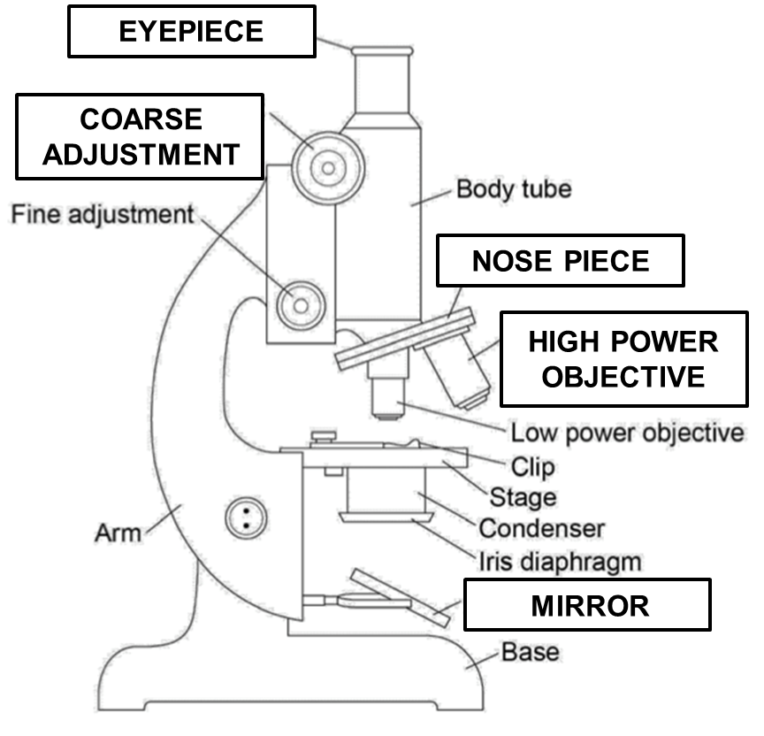
Magnification
In Biology, you may be asked to calculate the total magnification of an image (how much the image is made bigger).
To do this, we multiple the eyepiece magnification by the objective lens magnification.

Slide 4
Magnification
Let’s practice! MWBs
Eyepiece = x10
Objective lens = x100
Total magnification =
Eyepiece = x5
Objective lens = x400
Total magnification =
x1000
x2000

Slide 5
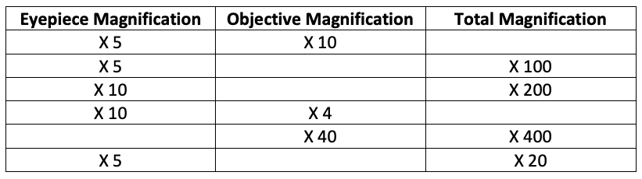
Magnification
TOTAL MAGNIFICATION = EYEPIECE X OBJECTIVE
Complete the table in your booklet: Page 3
X 50
X 20
X 20
X 40
X 10
X 4

Slide 6
Unit Conversion
There are 10mm in 1 cm
Notes:
Model the conversion in both directions under the visualiser/on the board

Slide 7
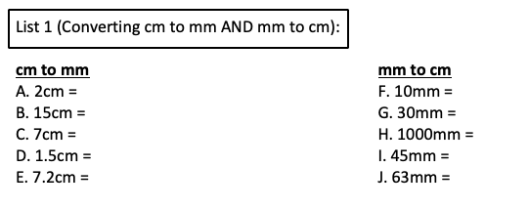
Rehearsal: Unit Conversion
2 x 10 = 20mm
10 / 10 = 1cm
15 x 10 = 150mm
30 / 10 = 3cm
7 x 10 = 70mm
1000 / 10 = 100cm
1.5 x 10 = 15mm
45 / 10 = 4.5cm
7.2 x 10 = 72mm
63 / 10 = 6.3cm
Notes:
Model the conversion in both directions under the visualiser/on the board

Slide 8
Unit Conversion
There are 1000 µm in 1 mm
Notes:
Model the conversion in both directions under the visualiser/on the board

Slide 9
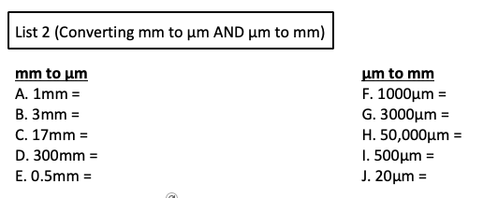
Rehearsal: Unit Conversion
1 x 1000 = 1000µm
1000 / 1000 = 1mm
3 x 1000 = 3000µm
3000 / 1000 = 3mm
17 x 1000 = 17000µm
50,000 / 1000 = 50mm
300 x 1000 = 300,000µm
500 / 1000 = 0.5mm
0.5 x 1000 = 500µm
20 / 1000 = 0.02mm
Notes:
Model the conversion in both directions under the visualiser/on the board

Slide 10
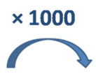
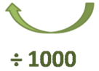
Unit Conversion
You need to be able to go between all three units in both directions.
µm
Notes:
Model some examples of conversions under the visualiser/on the board
I’m not sure which way round to go???

Slide 11
Unit Conversion
You need to be able to go between all three units in both directions.
x 1000
x 10
µm
mm
cm
÷1000
÷10
Notes:
Model some examples of conversions under the visualiser/on the board
I’m not sure which way round to go???

Slide 12
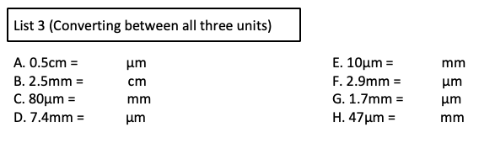
Rehearsal: Unit Conversion
5mm
5000
0.01
0.25
2900
0.08
1700
7400
0.047
Notes:
Model the conversion in both directions under the visualiser/on the board

Slide 13
Microscopy Calculations
If the image size is 4cm and the magnification is x100, what is the actual size of the sample in µm?
F FORMULA (get this from the formula triangle)
L LOOK (…for the values in the question)
I INSERT (…these values into the formula)
C CONVERT (any units that you need to)
C CALCULATE (…your answer)
Notes:
Model how to find the actual size from a given image size and a given magnification. Please change the example to a simpler one if you need to for your group.

Slide 14
Microscopy Calculations- MWB
If the image size is 4cm and the magnification is x100, what is the actual size of the sample in µm?
A = I / M
A = 4cm / 100
A = 40,000 µm / 100
A = 400 µm
F FORMULA (get this from the formula triangle)
L LOOK (…for the values in the question)
I INSERT (…these values into the formula)
C CONVERT (any units that you need to)
C CALCULATE (…your answer)
Notes:
Model how to find the actual size from a given image size and a given magnification. Please change the example to a simpler one if you need to for your group.

Slide 15
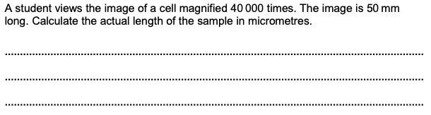
Rehearsal 1: Microscopy Calculations- Page 5
Actual = Image / Magnification
Actual = 50mm / 40,000
Actual = 50,000µm / 40,000
Actual = 1.25µm
F FORMULA (get this from the formula triangle)
L LOOK (…for the values in the question)
I INSERT (…these values into the formula)
C CONVERT (any units that you need to)
C CALCULATE (…your answer)
Notes:
Model the completion of this under the visualizer/on the board

Slide 16
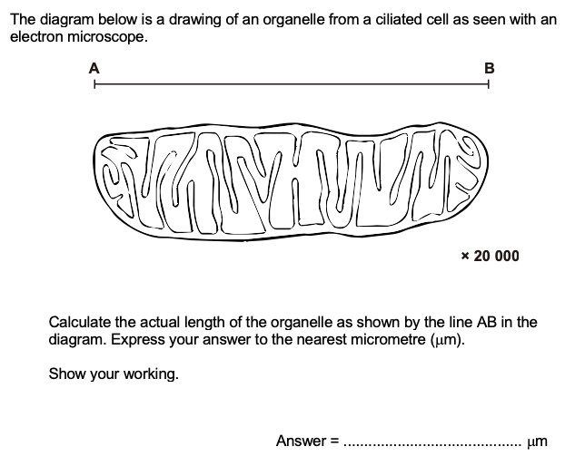
Rehearsal 2: Microscopy Calculations
Line AB = 10.2cm
F FORMULA (get this from the formula triangle)
L LOOK (…for the values in the question)
I INSERT (…these values into the formula)
C CONVERT (any units that you need to)
C CALCULATE (…your answer)
A = 10.2cm / 20,000
A = 102,000µm / 20,000
A = I / M
A = 5.1µm
5
Notes:
Model the completion of this under the visualizer/on the board

Slide 17
Surface area, Volume and Ratio
1- Surface area =
2- Volume =
Work out the area of one of the side and multiply by 6.
length x width x height

Slide 18
Rehearsal: Surface area, Volume and Ratio
Calculate the surface area of the cube
2. Calculate the volume of the cube
8x8 = 64
64 x 6 =
384cm²
8x8x8 =
512cm³

Slide 19
Rehearsal: Surface area, Volume and Ratio
3. Calculate the surface area to volume ratio (SA:V) of the cube
SA ÷ volume : 1
384 ÷ 512 : 1
= 0.8 : 1

Slide 20
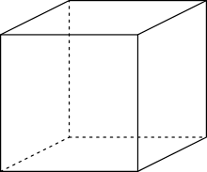
Rehearsal: Surface area, Volume and Ratio
4. Another cube has sides of 20cm.
Calculate the surface area to volume ratio of this object. Show all of your working (3 marks)
SA = (20 x 20) x 6
SA = 2400cm²
V = 20 x 20 x 20
V = 8000cm³
SA : V
2400 : 8000
0.3 : 1
The sides of this cube are 20 cm

Slide 21
Plot draw and interpret graphs
Creating and plotting a graph depends on the type of data being used.
Continuous variation is always measured in numbers. What examples of continuous variation can you think of?

Slide 22
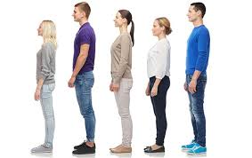
Continuous Variation
Human height is an example of continuous variation.
It ranges from the shortest person to the tallest person.
Any height is possible between these values. So it is continuous variation.
A characteristic that changes gradually over a range of values shows continuous variation, e.g. 151cm, 156cm, 157cm, 157.5cm.

Slide 23
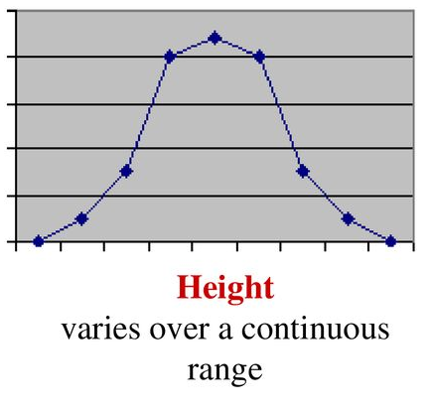
Continuous data should be plotted as a line graph.

Slide 24
When there are no values in between, this is discontinuous variation. These are groups or categories. What examples can you think of?

Slide 25
Rules for Graphs
A sharp pencil and ruler is used.
A graph title is given and underlined.
Units of measurement are given.
Both axes are correctly labelled.
All data points are plotted correctly.
The independent variable is along the x-axis and the dependent variable is along the y-axis.
The graph fills at least 2/3rd of the space available.
Line of best fit is drawn.

Slide 26
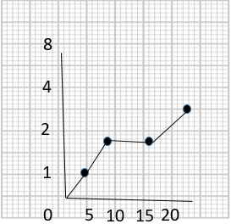
Rehearsal: Graphs
List the errors that you can see in this graph.

Slide 27
Let’s Practice!
List the errors that you can see in this graph.
Axis not drawn straight
Scale is not even
Lines are joined dot to dot
No line of best fit
No axis labels
No units
No title
Anomaly not identified.
What does this mean?

Slide 28
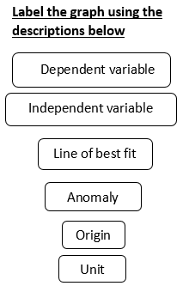
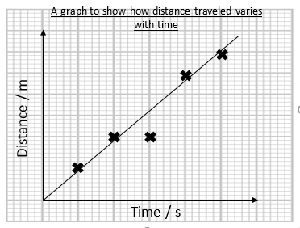
Rehearsal: Graphs

Slide 29
Unit
Line of best fit
Dependent variable
Anomaly
Origin
Unit
Independent variable

Slide 30
Task 1
You were going to measure the heights of your class mates and record the results in a tally chart. We will go around the room and say our height, or estimate it.
Height (cm) | Number of people
Below 120
120-129
130-139
140-149
150-159
160-169
Above 170

Slide 31
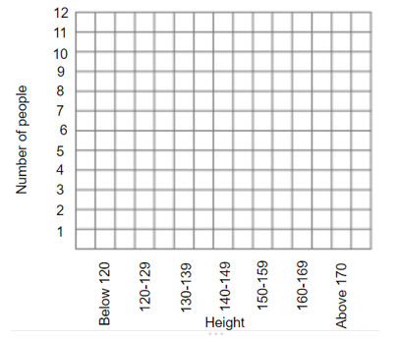
Task 2
Create a line graph to show your results.

Slide 32
Task 3
You have been given the eye colours of teachers at King’s. You need to create a table to record the results.
12 teachers have blue eyes
10 teachers have green eyes
22 teachers have brown eyes
2 teachers have grey eyes
4 teachers have hazel eyes

Slide 33
Task 3
Does your table look like this?
Eye colour | Number of people
Blue
Green
Brown
Grey
Hazel

Slide 34
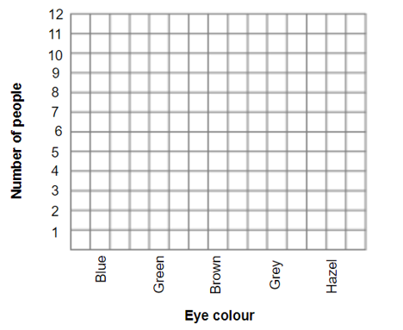
Task 4
Create a bar chart to show your results.

Slide 35
Time in minutes | Volume of carbon dioxide collected in cm³
0 | 0
1 | 46
2 | 70
3 | 85
4 | 94
5 | 96
6 | 96
7 | 96
Question 1
Plot a graph of the student’s results on the grid below.
Label the x axis and draw a line of best fit.

Slide 36
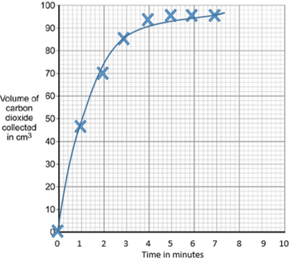
Time in minutes | Volume of carbon dioxide collected in cm³
0 | 0
1 | 46
2 | 70
3 | 85
4 | 94
5 | 96
6 | 96
7 | 96

Slide 37
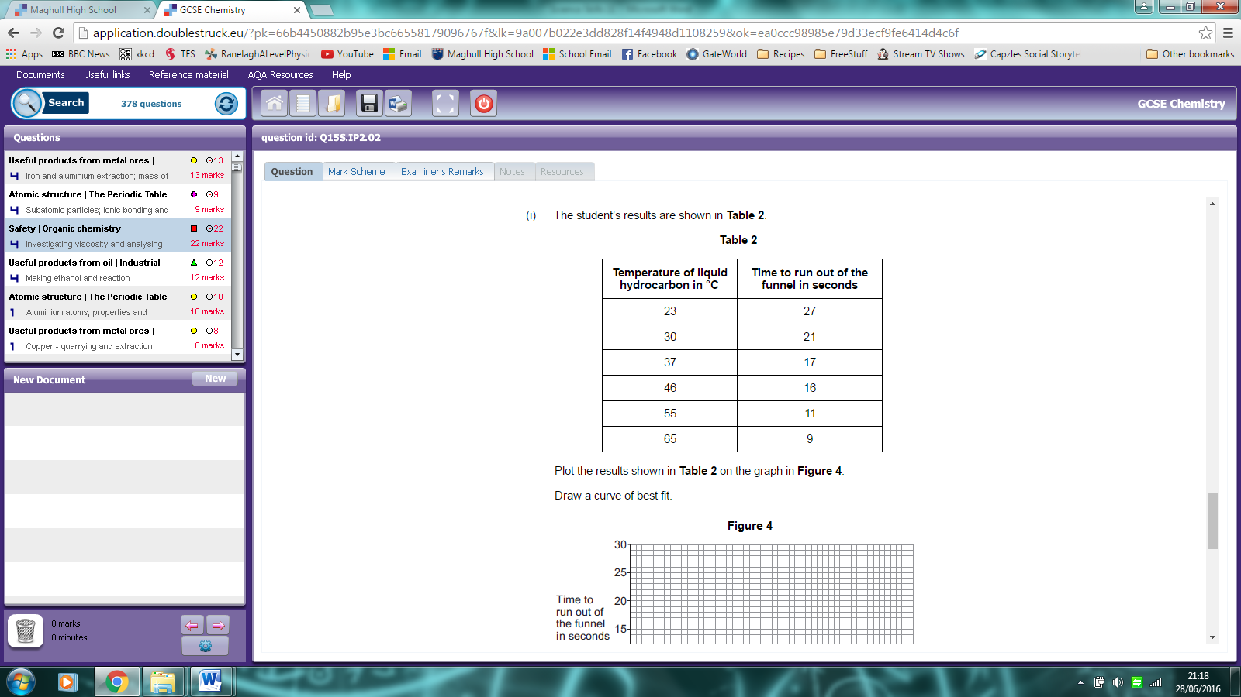
Question 2
Draw the results in the table on the graph paper below.
Draw an appropriate line of best fit.

Slide 38
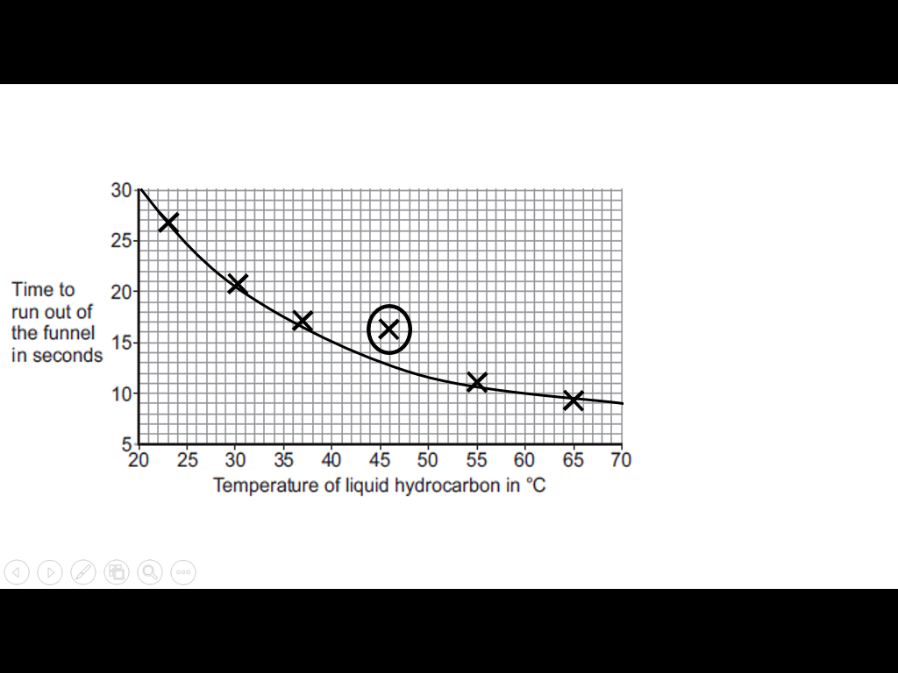

Slide 39
Rehearsal: Practice Questions
These questions will check your knowledge, understanding and application of maths in Science.
Make sure you read the question carefully and use any equations that are given to you.

Slide 40
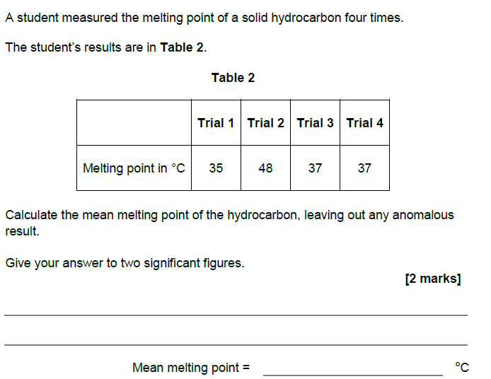
Rehearsal
Answer:
35+37+37=109
109/3 = 36

Slide 41
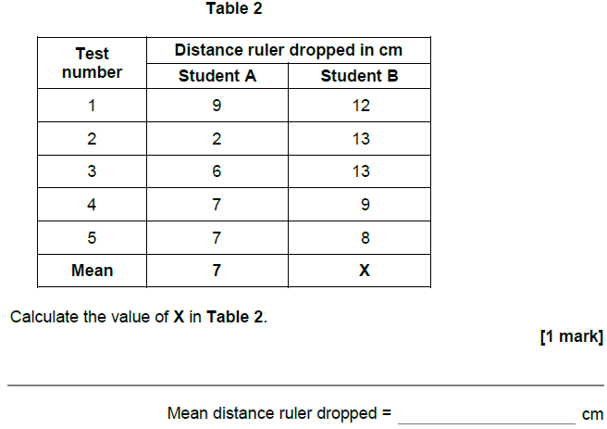
Rehearsal
Answer:
12+13+13+9+8= 55
55/5 = 11

Slide 42
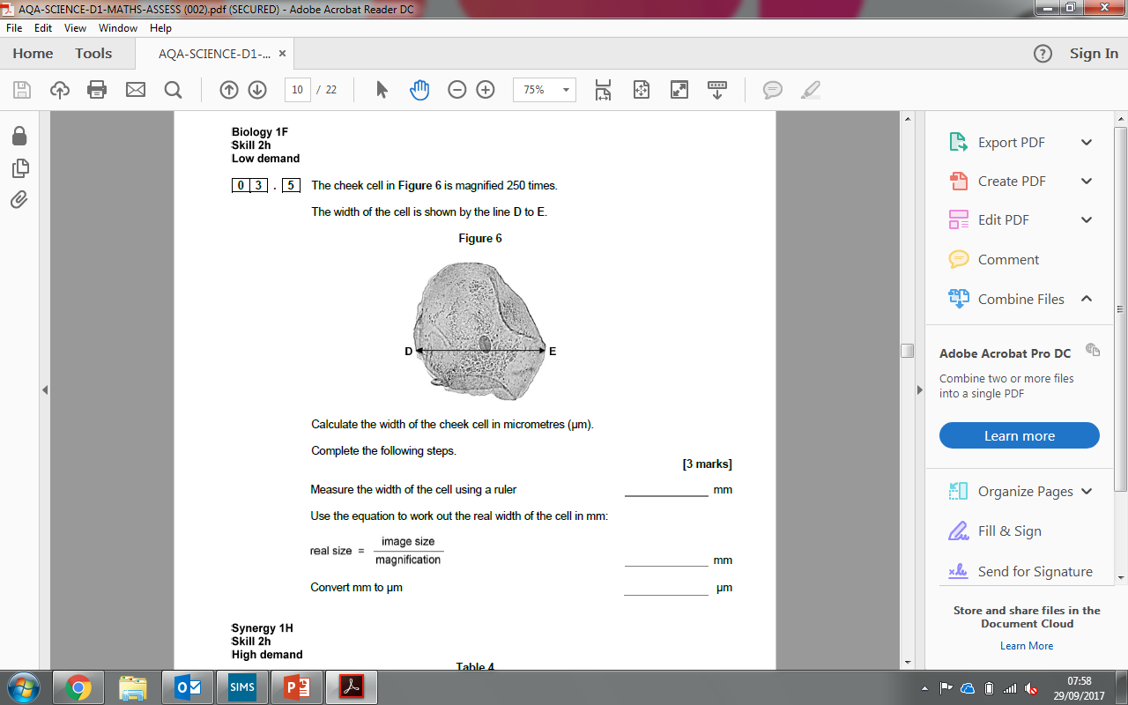
Rehearsal
Width = 45mm
Real size = 45/250 = 0.18
In µm= 180µm

Slide 43
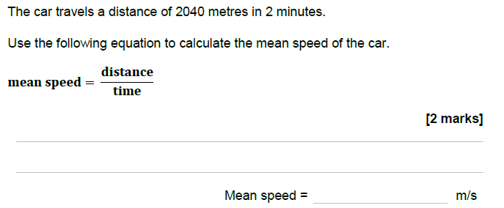
Rehearsal
Mean speed = 2040/120
17m/s

Slide 44
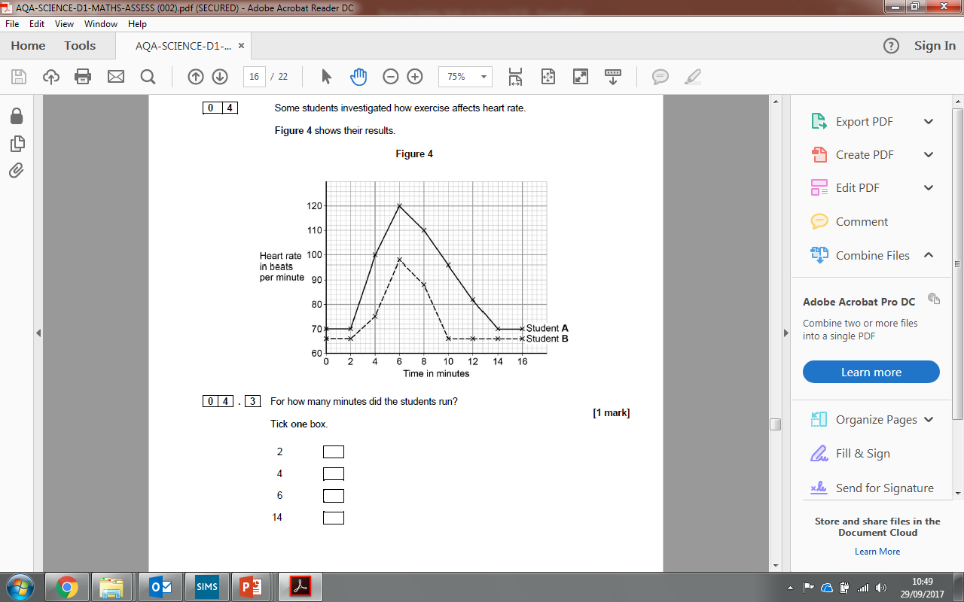
Rehearsal

Slide 45
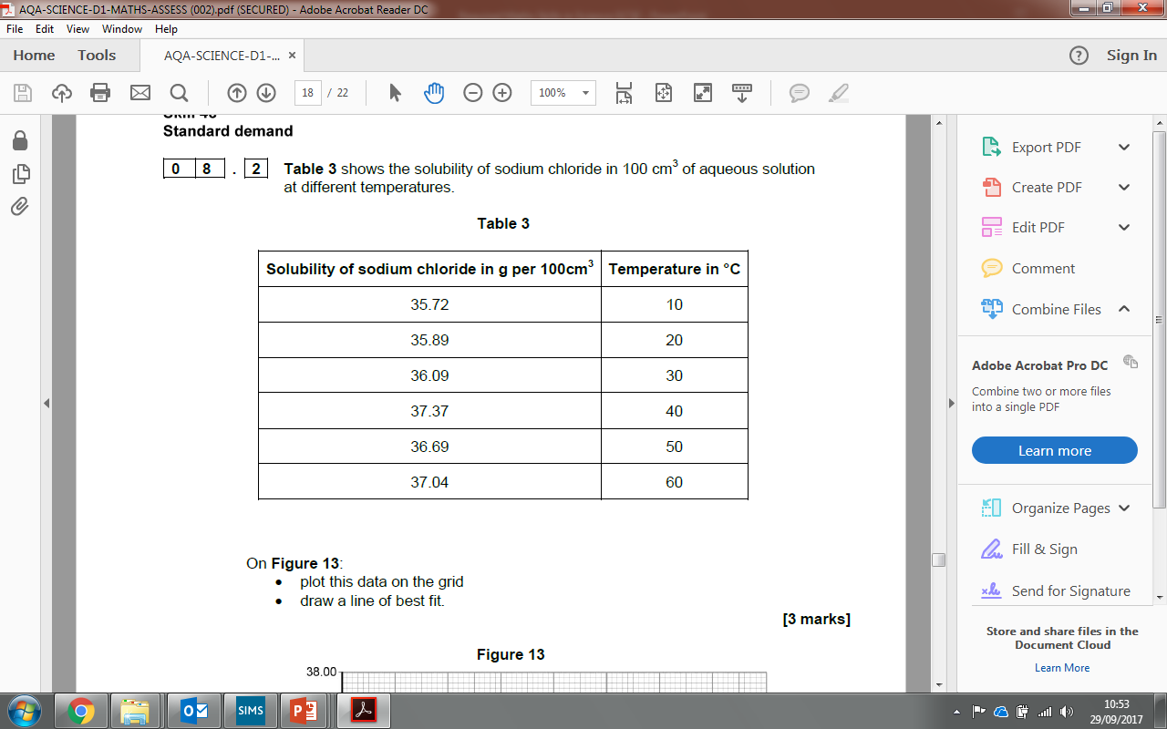
Rehearsal

Slide 46
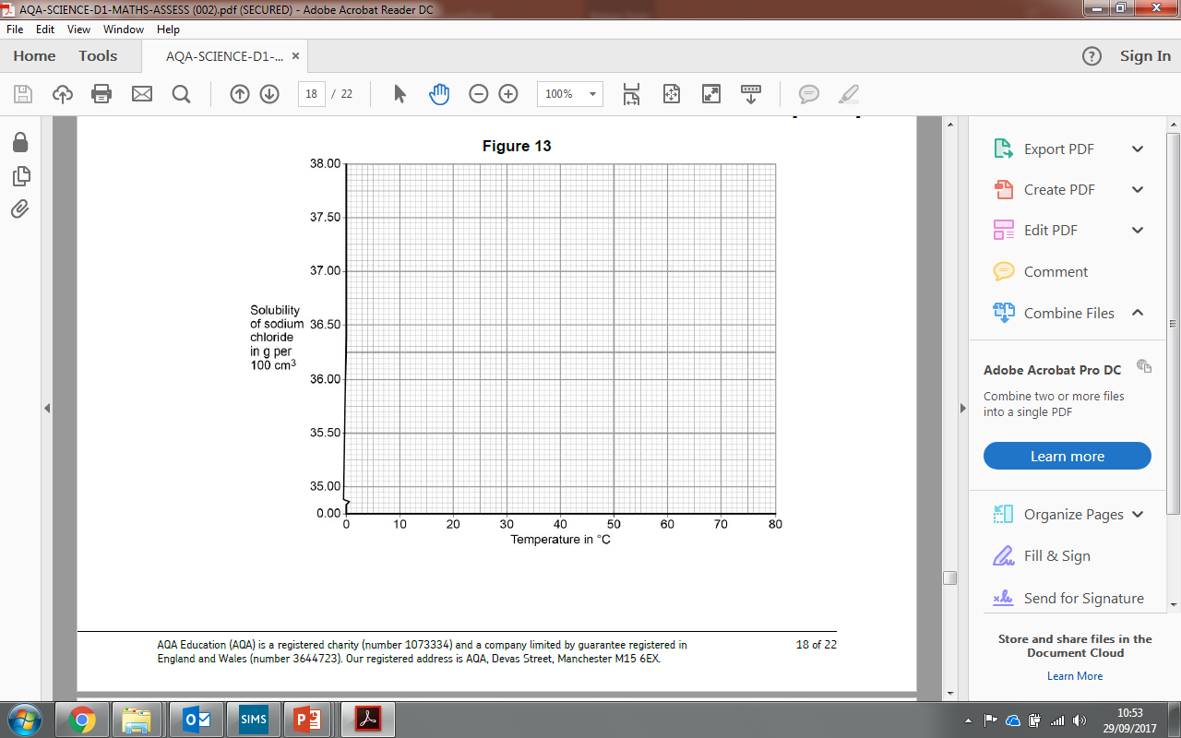
Rehearsal
Anomaly

Slide 47
Formula Triangles
In an exam you may be given an equation in a question that needs to be applied to your answer. Using the formula triangles, answer the questions in your booklet on page 20.
Remember to include units!

Slide 48
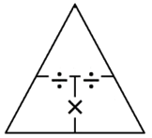
V
Voltage = Current x Resistance V = IR
Rearrange the equation to make current the subject
I = V / R
I
R
Rearrange the equation to make resistance the subject
R = V / I

Slide 49
Calculate the voltage if the current in a circuit is 3A and the resistance is 120Ω.
3 x 120 = 360V
Calculate the voltage if the current is 2.2A and the resistance is 50Ω.
50 x 2.2 = 110V
Calculate the current if the voltage is 120V and the resistance is 240Ω.
120 / 240 = 0.5A
Calculate the current if the voltage is 9V and the resistance is 450Ω.
9 / 450 = 0.02A
Calculate the resistance if the voltage is 200V and the current is 2.5A.
200 / 2.5 = 80Ω

Slide 50
Energy = Power x time E = Pt
E
P
t
Rearrange the equation to make current the subject
P = E / t
Rearrange the equation to make resistance the subject
t = E / P

Slide 51
Calculate the energy if the power is 30W and the time is 120s.
30 x 120 = 3600J
Calculate the energy if the time is 2 minutes and the power is 50W.
2x 60 = 120 seconds 120 x 50 = 6000J
Calculate the power if the energy is 1200J and the time is 12s.
1200 / 12 = 100W
Calculate the power if the time is 30s and the energy is 9000J.
9000 / 30 = 300W
Calculate the time if the energy is 2000J and the power is 25W.
2000 / 25 = 80s

